Slide 1


The Food Network for Ethical Trade (FNET)
Retailer meeting on gender 25th october 2022
FOOD NETWORK FOR ETHICAL TRADE – CONFIDENTIAL

Slide 2
Competition Law Statement
“Today we are meeting to discuss the Food Network for Ethical Trade.
We take competition compliance seriously. Whilst discussions can cover matters of interest to our industry, we cannot discuss or exchange sensitive commercial information.
If at any time during this meeting, you think our discussions may be in breach of competition rules, please inform the Chair. The Chair may close the meeting at any time if she believes that discussions are in breach of competition law”
2

Slide 3
Agenda
Approximate timing | Item
1.30 – 1.40 | Introductions and objectives
1.40 – 2.00 | Member case study sharing
2.00 – 2.15 | Discussion
2.15 – 2.25 | ETI Data Initiative - Halima Ahmed, ETI
2.25-2.35 | Sedex Data Integration – Clare Fitton, Sedex
2.35 – 2.55 | Discussion
2.55 – 3.00 | Next Steps and Close
3

Slide 4


Slide 5
DISCUSSION POINTS
How is work on gender structured within your company?
How is/was the strategy developed?
What are some of the key challenges and opportunities with implementation?
Are there areas you would like to learn from each other or collaborate on?
How can FNET help?

Slide 6
Agenda
Approximate timing | Item
1.30 – 1.40 | Introductions and objectives
1.40 – 2.00 | Member case study sharing
2.00 – 2.15 | Discussion
2.15 – 2.25 | ETI Data Initiative - Halima Ahmed, ETI
2.25-2.35 | Sedex Data Integration – Clare Fitton, Sedex
2.35 – 2.55 | Discussion
2.55 – 3.00 | Next Steps and Close
6

Slide 7
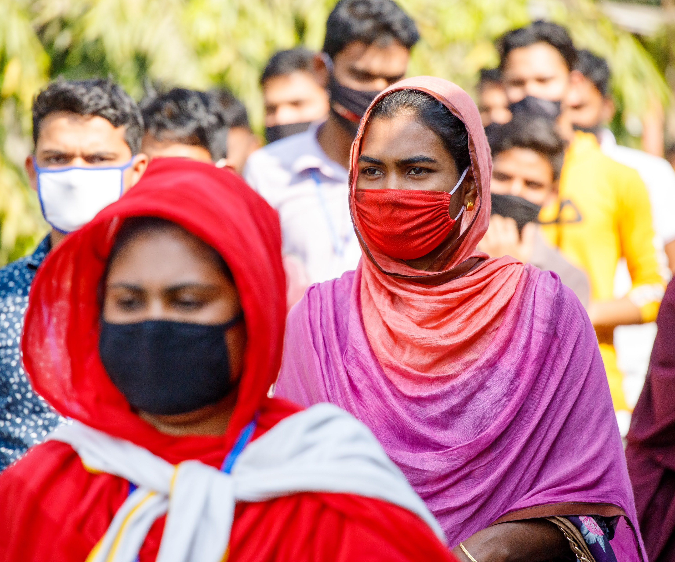
ETI Gender Data Initiative

Slide 8
Objectives
  Develop corporate member understanding of the benefits of collecting and utilising gender-disaggregated supply chain data
  Provide guidance/resources to enable collection of a minimum set of data indicators (Level 1)
  Corporate members are able to utilise data to advance gender equality in their supply chains

Slide 9
Guidance
Level 1
Level 2
Level 3
Understand a wide range of potential gendered risks
Deep dive into specific gendered risks
Assess workforce composition and key business risks
Please visit ETI website/ETI Community for more information!

Slide 10


Gender data integration
25th October 2022

Slide 11



Sedex’s position on gender data
Industry initiatives inform and agree gender indicators
Sedex platform integrates datapoints (Site profile, SAQ, SMETA)
Dashboards for members to interpret results
Notes:
KATE
The three L1 indicators not included are 1) number of workers in trade unions, 2) number of workers in worker committees, 3) % of employees regularly working overtime.
Other questions linked to gender in the draft SAQ are:
What does your company do to prevent violence and harassment, including sexual harassment? (Select all that apply)
What does your company do to ensure gender equality and women's empowerment? (Select all that apply)
Alignment with BSR indicators will continue to be our strategy, given the need to mitigate data collection burden, the endorsement of this framework by our members, and the focus of BSR’s measurement of the outcome on workers.
BSR Gender Data and Impact Framework (GDI) Report and Tool
https://www.bsr.org/en/our-insights/report-view/making-women-workers-count-gender-responsive-due-diligence-report

Slide 12
Where can you gender information on Sedex?
BSR Level 1 Indicators | Site Profile | SAQ | Other
Workers by contract type | ✔
Migrant workers | ✔
Management, supervisors & administrative staff |  | ✔
Turnover and absenteeism rates |  | ✔
Worker representation |  |  | Worker interviews? - pilot
Overtime hours |  |  | SMETAx pilot
Reference: BSR Level 1 indicators
https://www.ethicaltrade.org/sites/default/files/shared_resources/ETI_GenderDataGuidance_L1.pdf
sedex.com
Notes:
KATE
We’ve just been shown a list of indicators that can help to get you started with understanding gender issues in your supply chain. And a lot of this information can already be found on Sedex.
Within the Site Profile, you have information on the workforce in your business and supply chain. The platform asks for worker information to be input by gender, split into temporary, permanent, low season and high season and migrant workers.
Then, the SAQ asks about the types of positions that women hold. It gathers information on the gender breakdown of management, supervisors and administrative staff.
The SAQ also asks for a breakdown of turnover and absenteeism rates.
As a follow-up to this event, I will share guidance on where to find the information, and the definitions of these terms.
And, as an action point to take away from this session, I will ask you to have a look at where and whether this data is within the Sedex platform, and what it might be telling you.

Slide 13
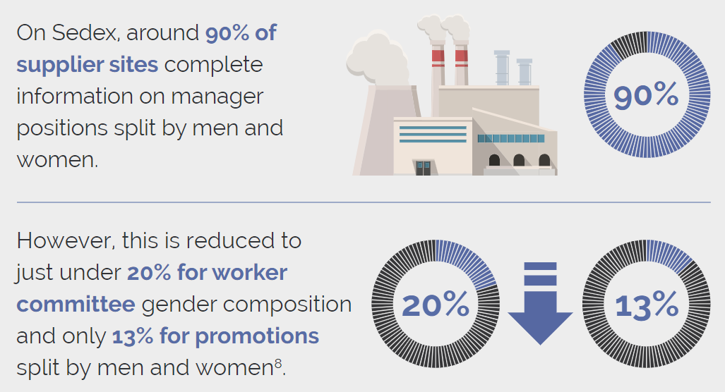
Collection and monitoring of gender data at a site level
Notes:
KATE

Slide 14
Data improvement
Analysis of where data is ‘rogue’ – highlight and look for data fixes
Prompts to suppliers to ask if data is accurate
Mandatory data fields
Dashboards to present data in an easily accessible fashion
Engage with MSIs and businesses to understand how the data is being used so we know what else to include

Slide 15
Discussion
Are there any glaring gaps in data that is required by retailers?
Is there appetite among retailers to collaborate on collecting data for Level 2 indicators or around specific risk areas?
Are there other areas that retailers wish to align/collaborate on with regards to gender disaggregated supply chain data?

Slide 16


