Slide 1
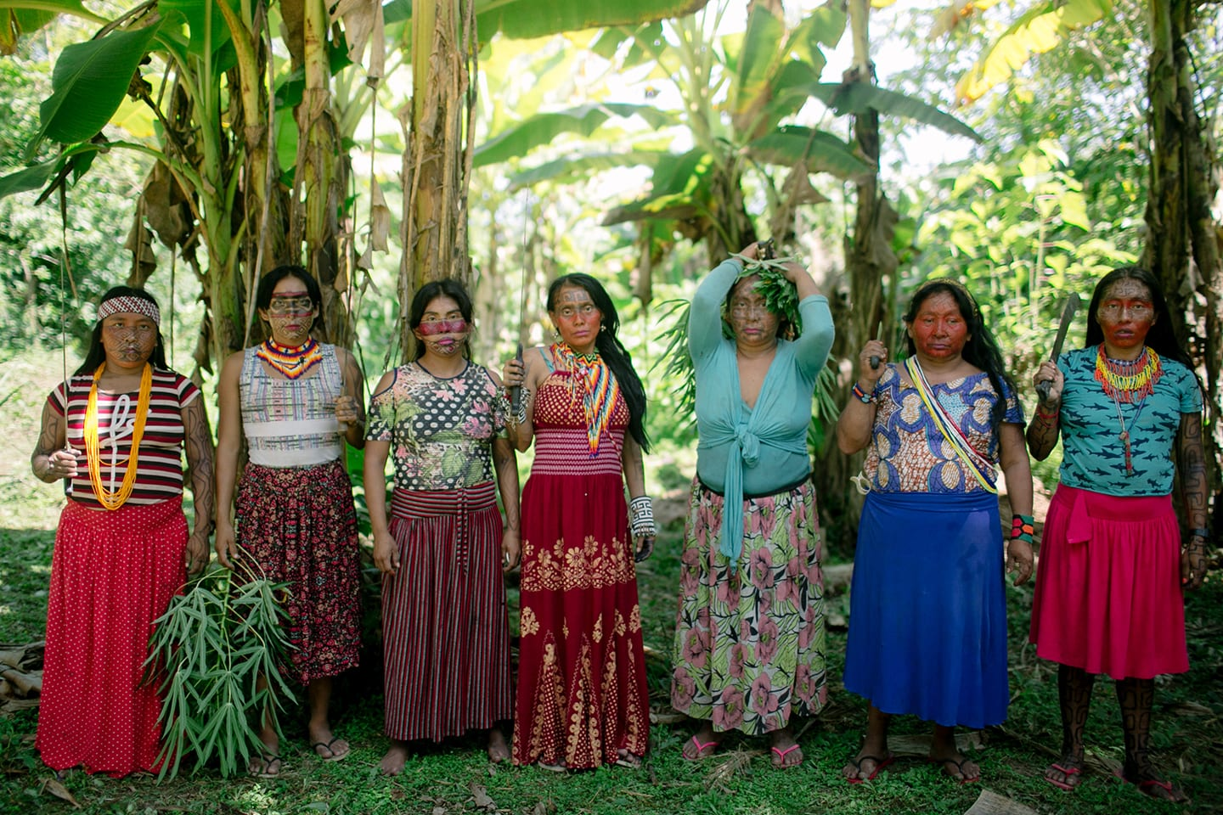
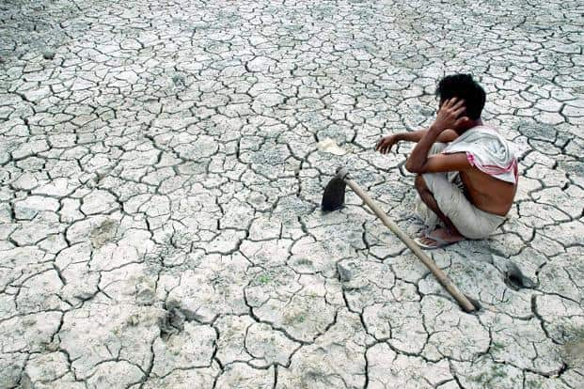
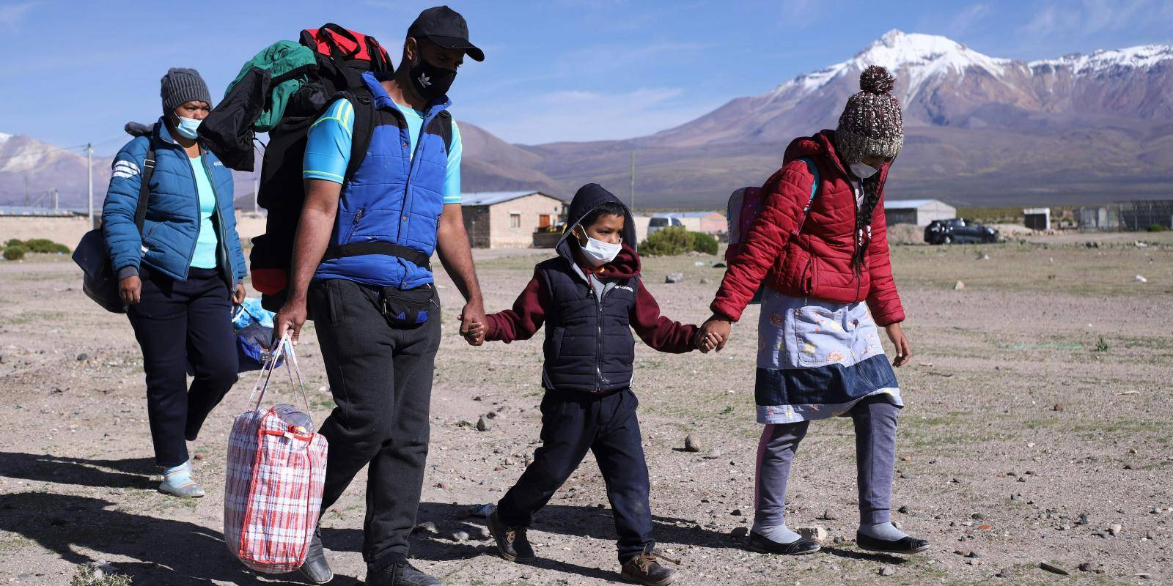
CLIMATE CHANGE WORKING GROUP
Climate change risks and opportunities
through a
human rights / ethical trade lens

Slide 2
AGENDA
Recording can be found here Access Passcode: $9fNJ.!3
Introductions, housekeeping & purpose of the call
Ben Summers, Sustainability Manager & Human Rights Lead, Innocent
Natalie McWilliam, Group Head of Sustainable Sourcing, DPS
Q&A for both speakers

Slide 3
Why are we here today?
Through collaborative working the aim is to build capacity by sharing insight and best practice;
Opportunities to act as one collective voice to address human rights and climate change issues in our supply chains;
Bring our collective knowledge together to highlight activity that is already taking place;
Broaden our reach out to other functions – environmental/sustainability and procurement colleagues;
Today’s call will ultimately contribute to:
Supporting members to understand climate change risks through a human rights lens;
Notes:
Introductions – me, Paul and Victoria board sponsors
GDPR reminder – ??
Agenda – what we will cover
Housekeeping – stay on mute to limit interference, there will be time for questions after both speakers have completed their talks, please either use the chat function as we progress for comments or questions, alternatively raise your hand
Move to next slide to remind all members about why we are here and how this specific session contributes to our end goal

Slide 4

Desired outputs for the session
  Shape the objectives for the working group
  Share perspectives from members
  Discuss focus areas for future meetings
  Request for lead and co-lead
Key words for the session:
Collaboration / Openness / Inclusive / Supportive

Slide 5
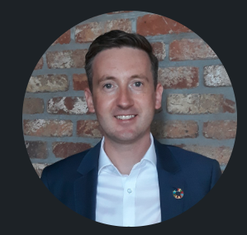
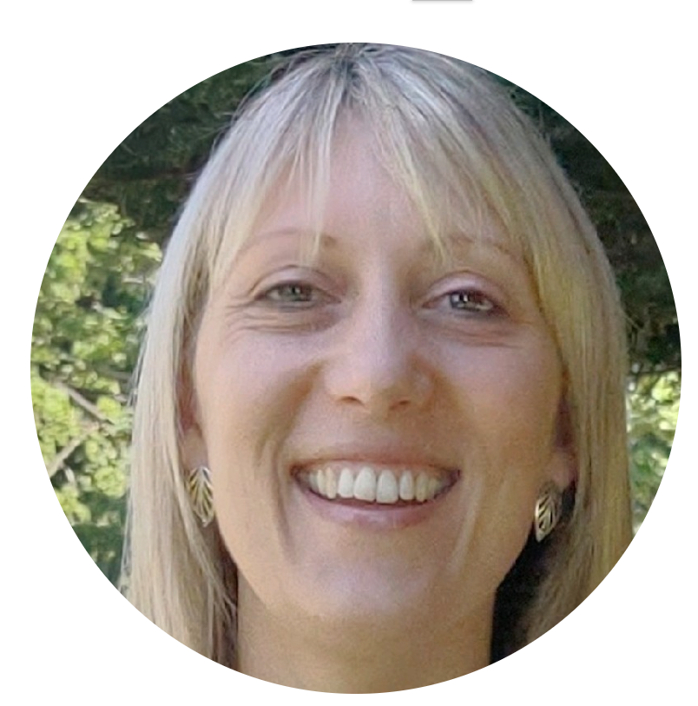
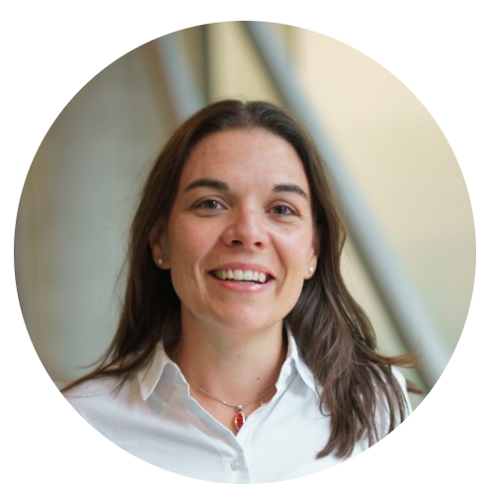

WORKING GROUP LEADS
Paul Williams (Princes)
Board Co-Sponsor
Deborah Carlin (Müller)
Board Co-Sponsor
Vicky Dodman (M&S)
Board Co-Sponsor
(Vacancy from 1st August 2022)
Working Group Lead
(Vacancy)
Working Group Co-Lead
(Vacancy)

Slide 6
Q&A
Member expressed a wish for access to DPS’ methodology
DPS will update presentation and circulate. Happy to share data gathering form. Have since changed methodology to include Sedex Radar, WWF Water Filter
Member enquired into the balance of qualitative vs anecdotal data collected in DPS assessment.
DPS – more qualitative in trial, but has since become more quantitative.
Notes for future meetings; extend session time, focus theme – some ideas around nature-related financial disclosures & responsible exit strategies.
AP – FNET to circulate survey and next meeting date for diary.

Slide 7

FNET climate change working group
July 2022

Slide 8

Climate change risks through an ethical trade lens
Manage impacts of unavoidable emissions & climate change
Responsible adaptation to avoid unnecessary emissions
Notes:
Risks of climate change – damage to assets from sea level rise / extreme weather events
Risks of adaptation – moving business from region x to region y, requiring carbon reductions – sharing risk, equitable access to finance, technology, expertise that enable change

Slide 9

Status quo
“Putting people and justice at the centre of business efforts to address the climate emergency will be no easy feat, but it must be done. Climate activists have been trying to solve the climate crisis for nearly 50 years, but have barely moved the needle because they have not collectively centred the people and lived experiences of those most affected to build solutions together. This next decade—the Decade of Action—is pivotal for climate action, and the pathway to effective climate action is to listen to and incorporate the wisdom of the people and communities most impacted. We have to work collaboratively to create the sustainable and just future we want; not in siloes, and not through the paternalistic, colonialist, and saviourist methodologies that got us here.”
Dr. Ellonda Williams, Director of Justice, Equity, Diversity, & Inclusion at B Lab.
Notes:
We already have a SBT for carbon reduction – tracked on our business score card
But, this quote still rings true.
So I’m working on: 1) education, 2) recognition, 3) aspiration, 4) governance ...

Slide 10
Status quo
“Putting people and justice at the centre of business efforts to address the climate emergency will be no easy feat, but it must be done. Climate activists have been trying to solve the climate crisis for nearly 50 years, but have barely moved the needle because they have not collectively centred the people and lived experiences of those most affected to build solutions together. This next decade—the Decade of Action—is pivotal for climate action, and the pathway to effective climate action is to listen to and incorporate the wisdom of the people and communities most impacted. We have to work collaboratively to create the sustainable and just future we want; not in siloes, and not through the paternalistic, colonialist, and saviourist methodologies that got us here.”
Dr. Ellonda Williams, Director of Justice, Equity, Diversity, & Inclusion at B Lab.
Notes:
We already have a SBT for carbon reduction – tracked on our business score card
But, this quote still rings true.
So I’m working on: 1) education, 2) recognition, 3) aspiration, 4) governance ...

Slide 11
Take the eye patch off
Climate justice
Manage impacts
Responsible adaptation
Involve people & communities
Notes:
Ambition: strengthen innocent's engagement of climate action to serve planet AND people

Slide 12

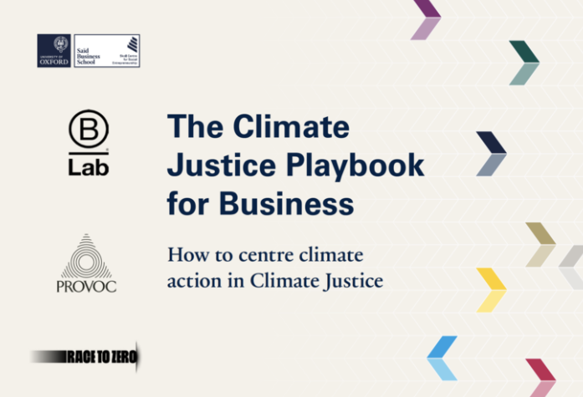


Education: What is climate justice & who’s working on it?
Climate justice links everything we are doing in addressing the climate emergency to human rights and social development, taking a human-centred approach and placing people and equity at the core.
Minimising GHG emissions while maximising positive investments and actions to increase resilience and enable the transition to low carbon development.
TONZ; Maersk, Danone, Mercedes-Benz, Microsoft, Nature &Co, Nike, Starbucks, Unilever, Wipro, EDF.
Notes:
First UN summit at COP6 in 2000, Transform to Net Zero launched in 2020, B Lap playbook launched 2021.

Slide 13

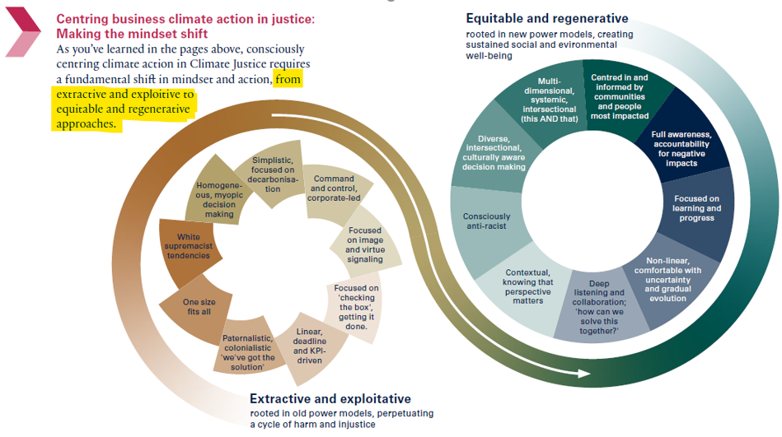
Climate justice is…
Transformative for people and planet (output, outcome, impact)
Inclusive decision making (context)
Shares benefits and burdens equitably (collaboration)
Transparent and accountable (communication)
Notes:
grouped along the lines of procedural justice, which emphasizes fair, transparent and inclusive decision making, and distributive justice, which places the emphasis on who bears the costs of both climate change and the actions taken to address it
Short-term remove the eye patch
Long-term agitate for business model transformation / systems change

Slide 14



Manage impacts
Risk assessments
Responsible exit policy?
Sourcing standards scope
Notes:
Expand scope of our risk assessments & SoS approval process - Previously Risk assessment ONLY environmental for 2030 – extreme weather, temp, land degradation, water stress
Responsible exit policy – does anyone have one?
Watch how standards advance

Slide 15


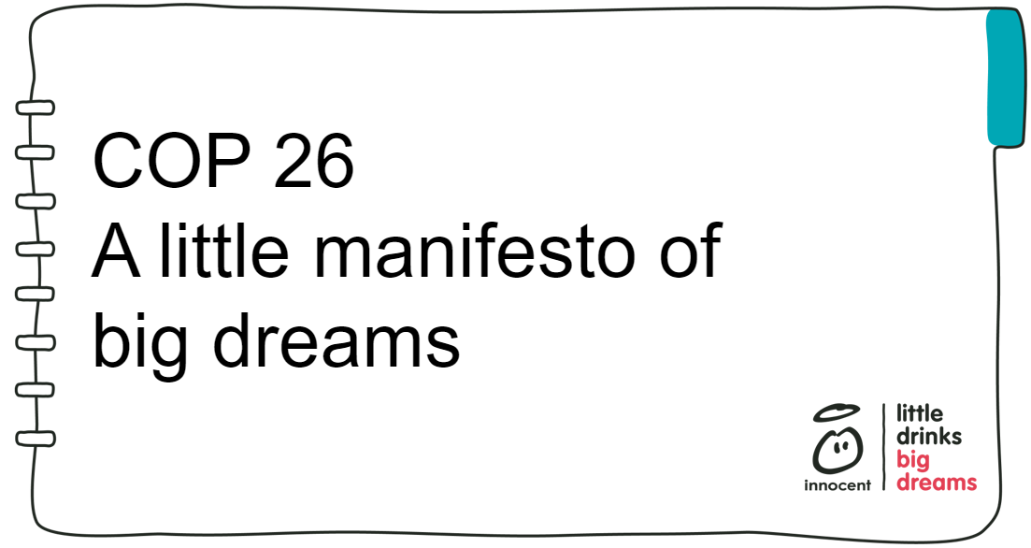
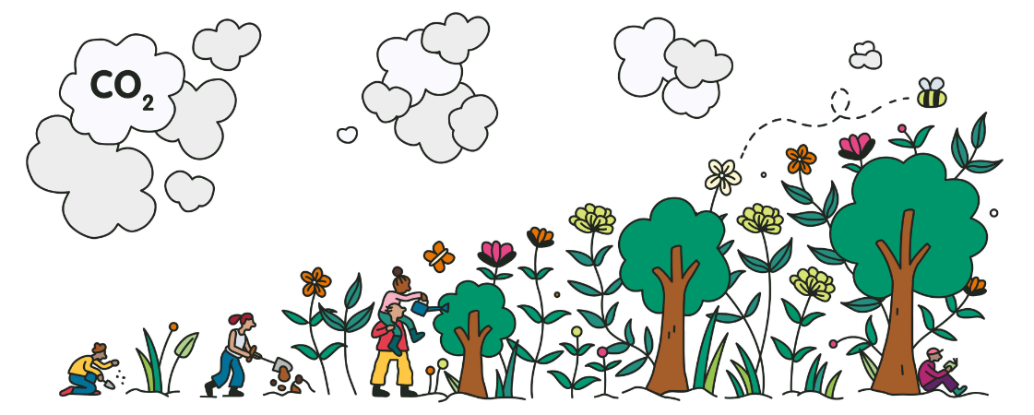
Responsible adaptation
Farmer Innovation Fund
Business development training
Advocacy with
other actors
Gold standard carbon credits
Notes:
Manifesto inc. advocacy for farming livelihoods, support for SHFs
We buy gold standard carbon credits for any offsets e.g. reforestation in Uruguay which includes FSC forestry as new income opportunity

Slide 16

What next?
Set aspirations
Set governance
Keep learning
Keep improving

Slide 17
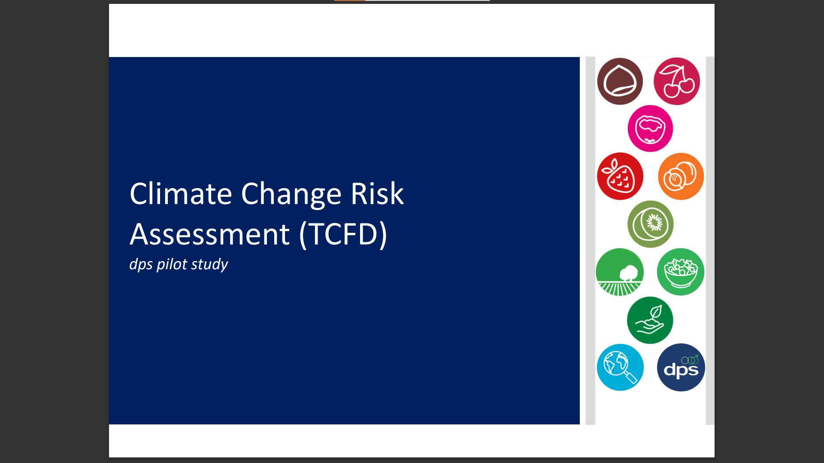

Slide 18
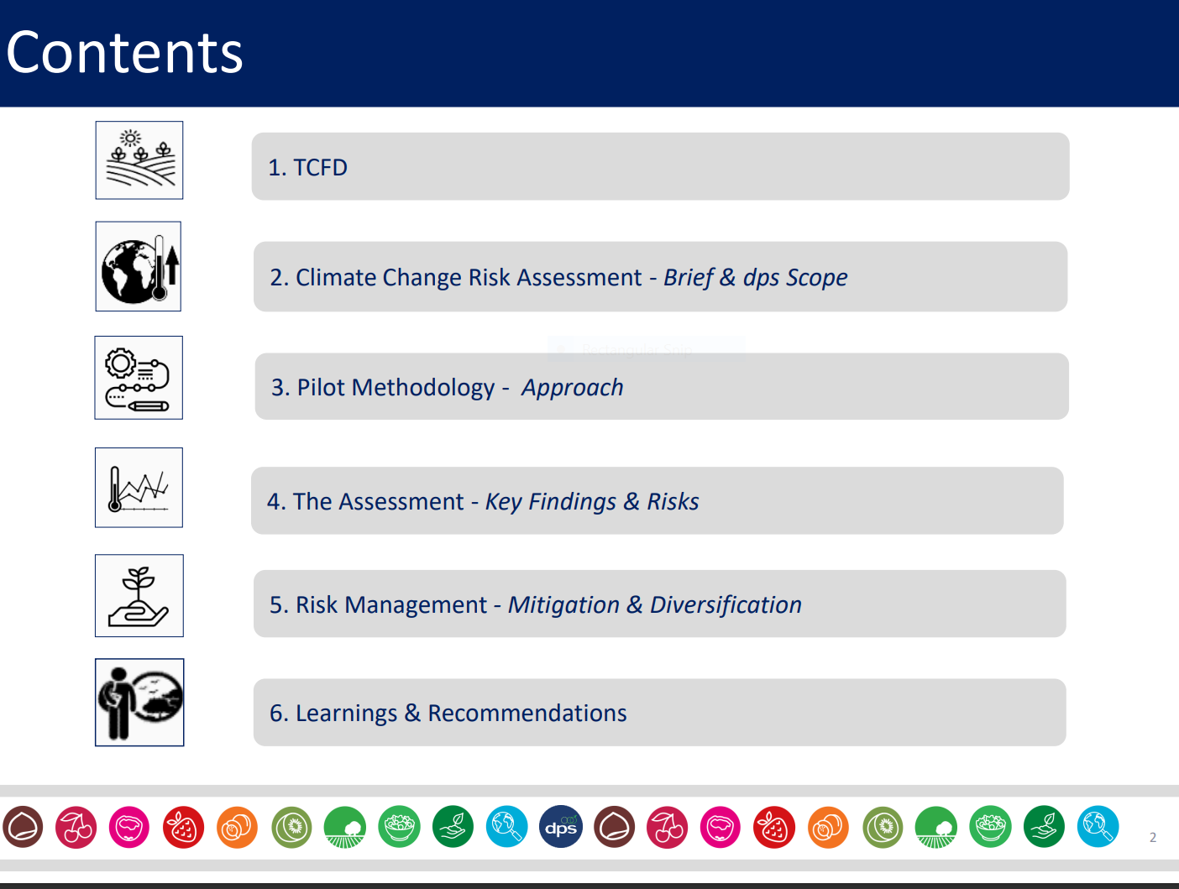

Slide 19
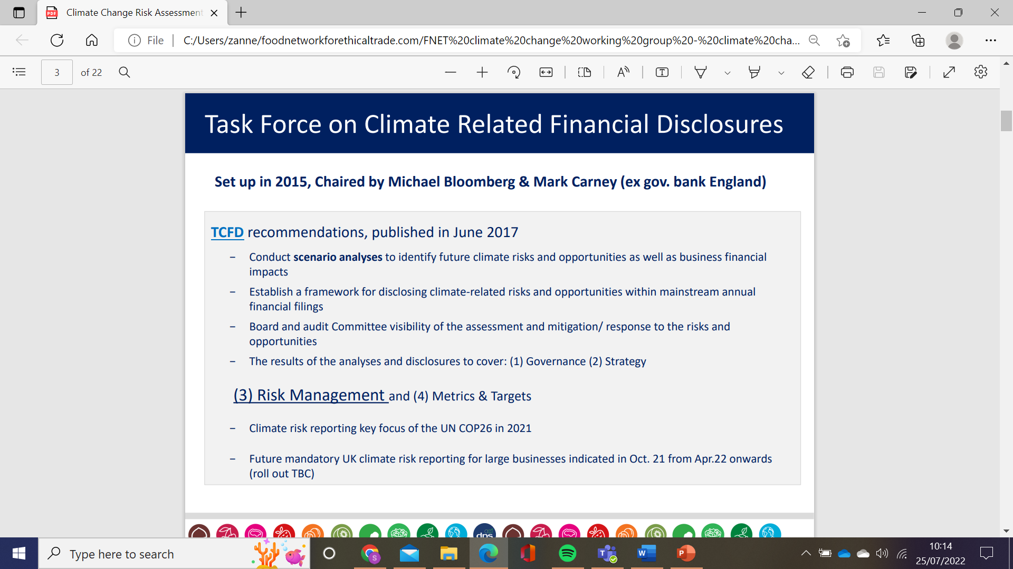

Slide 20
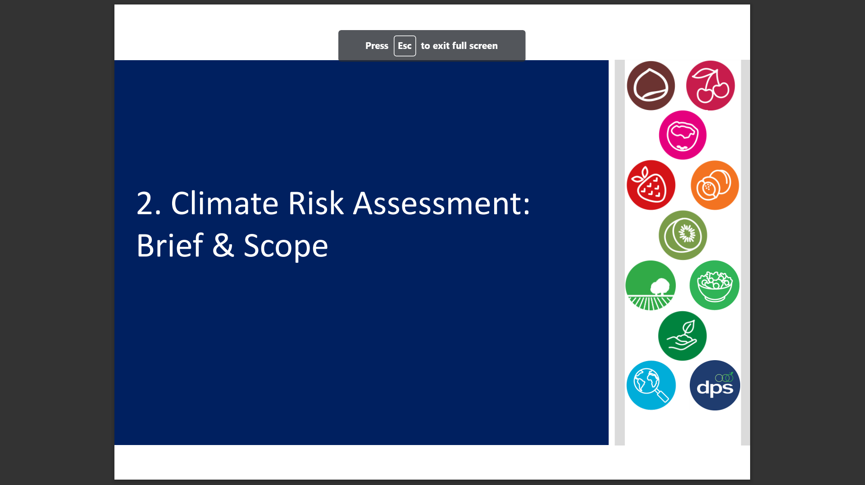

Slide 21
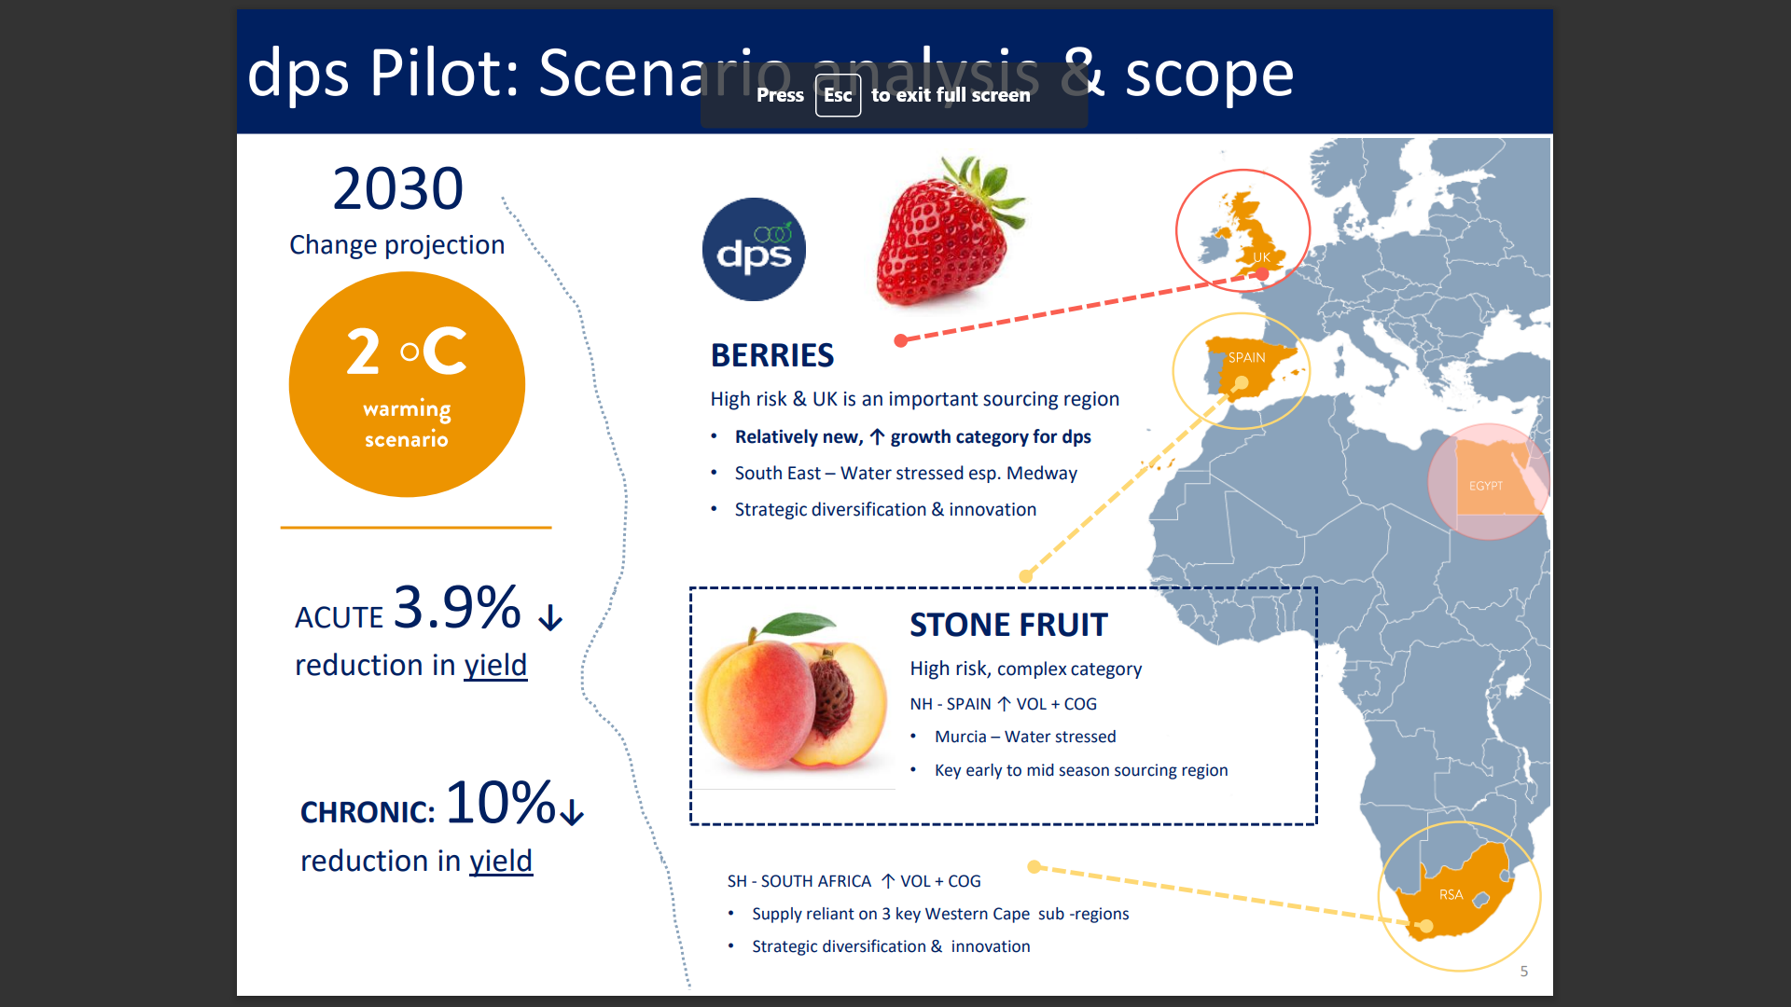

Slide 22
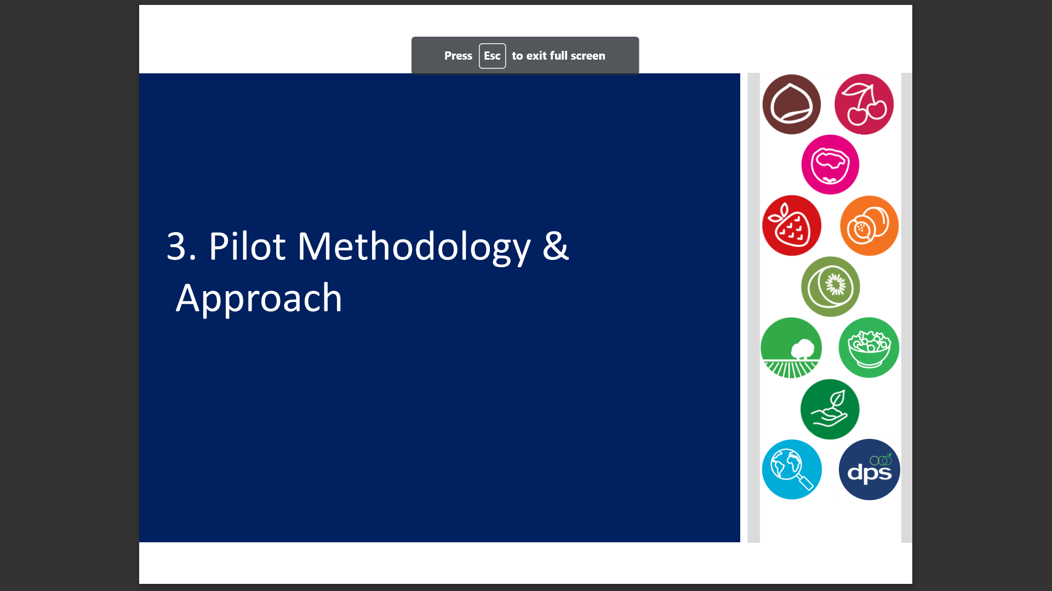

Slide 23
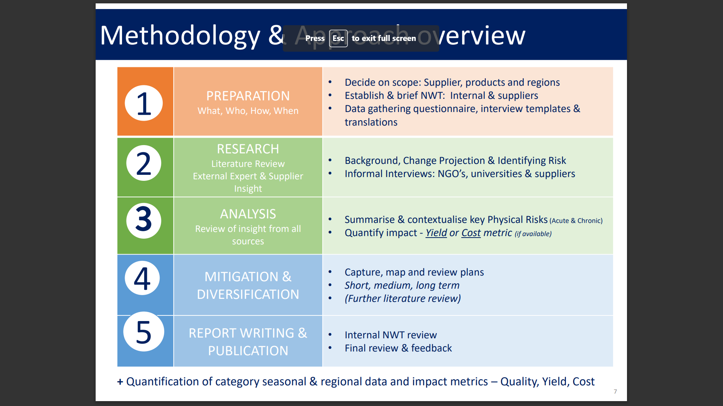

Slide 24
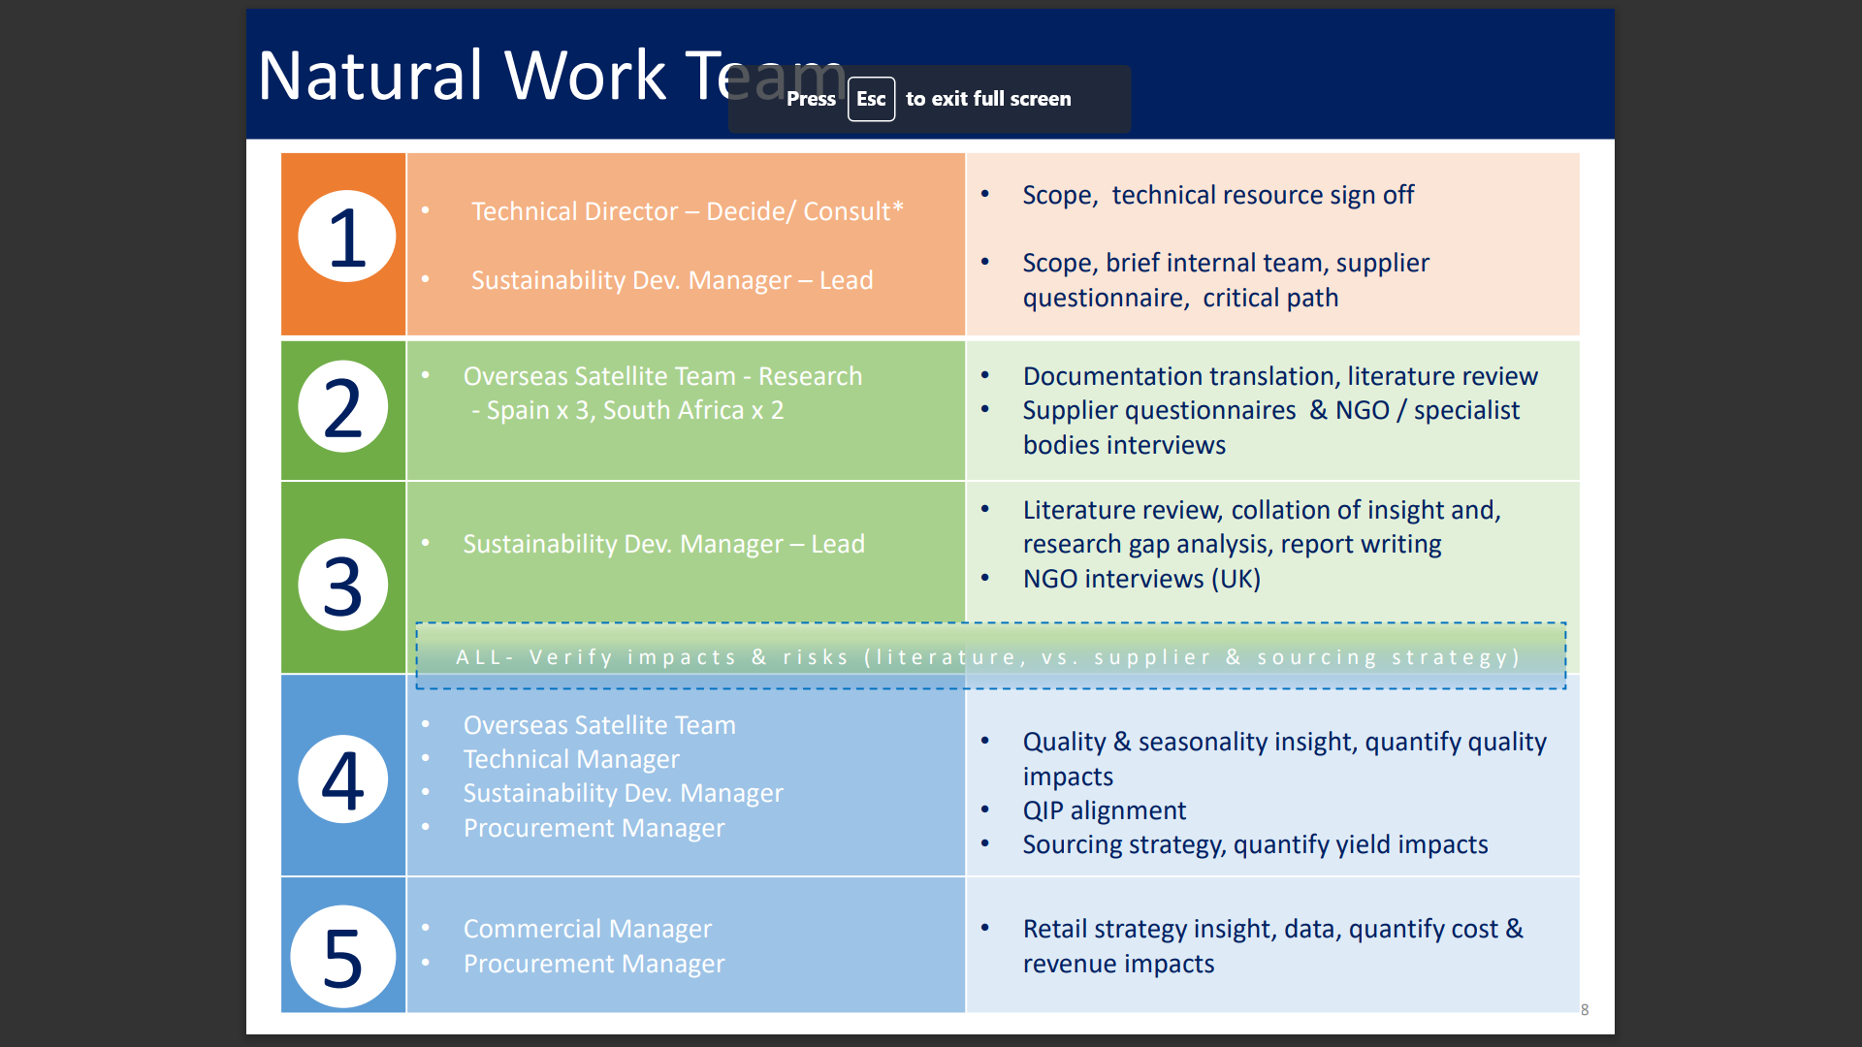

Slide 25
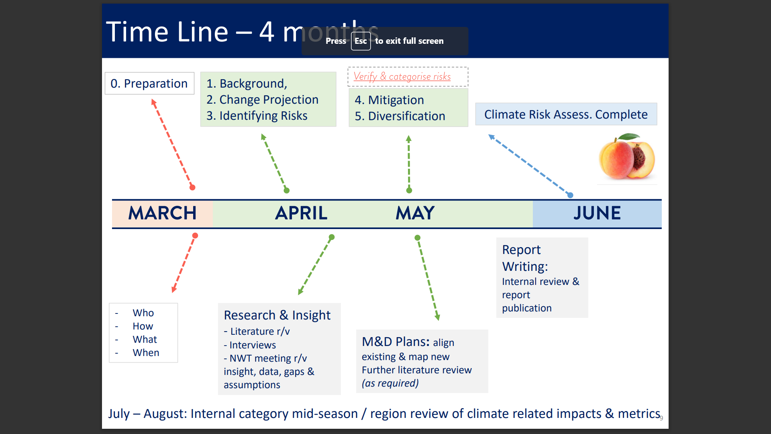

Slide 26
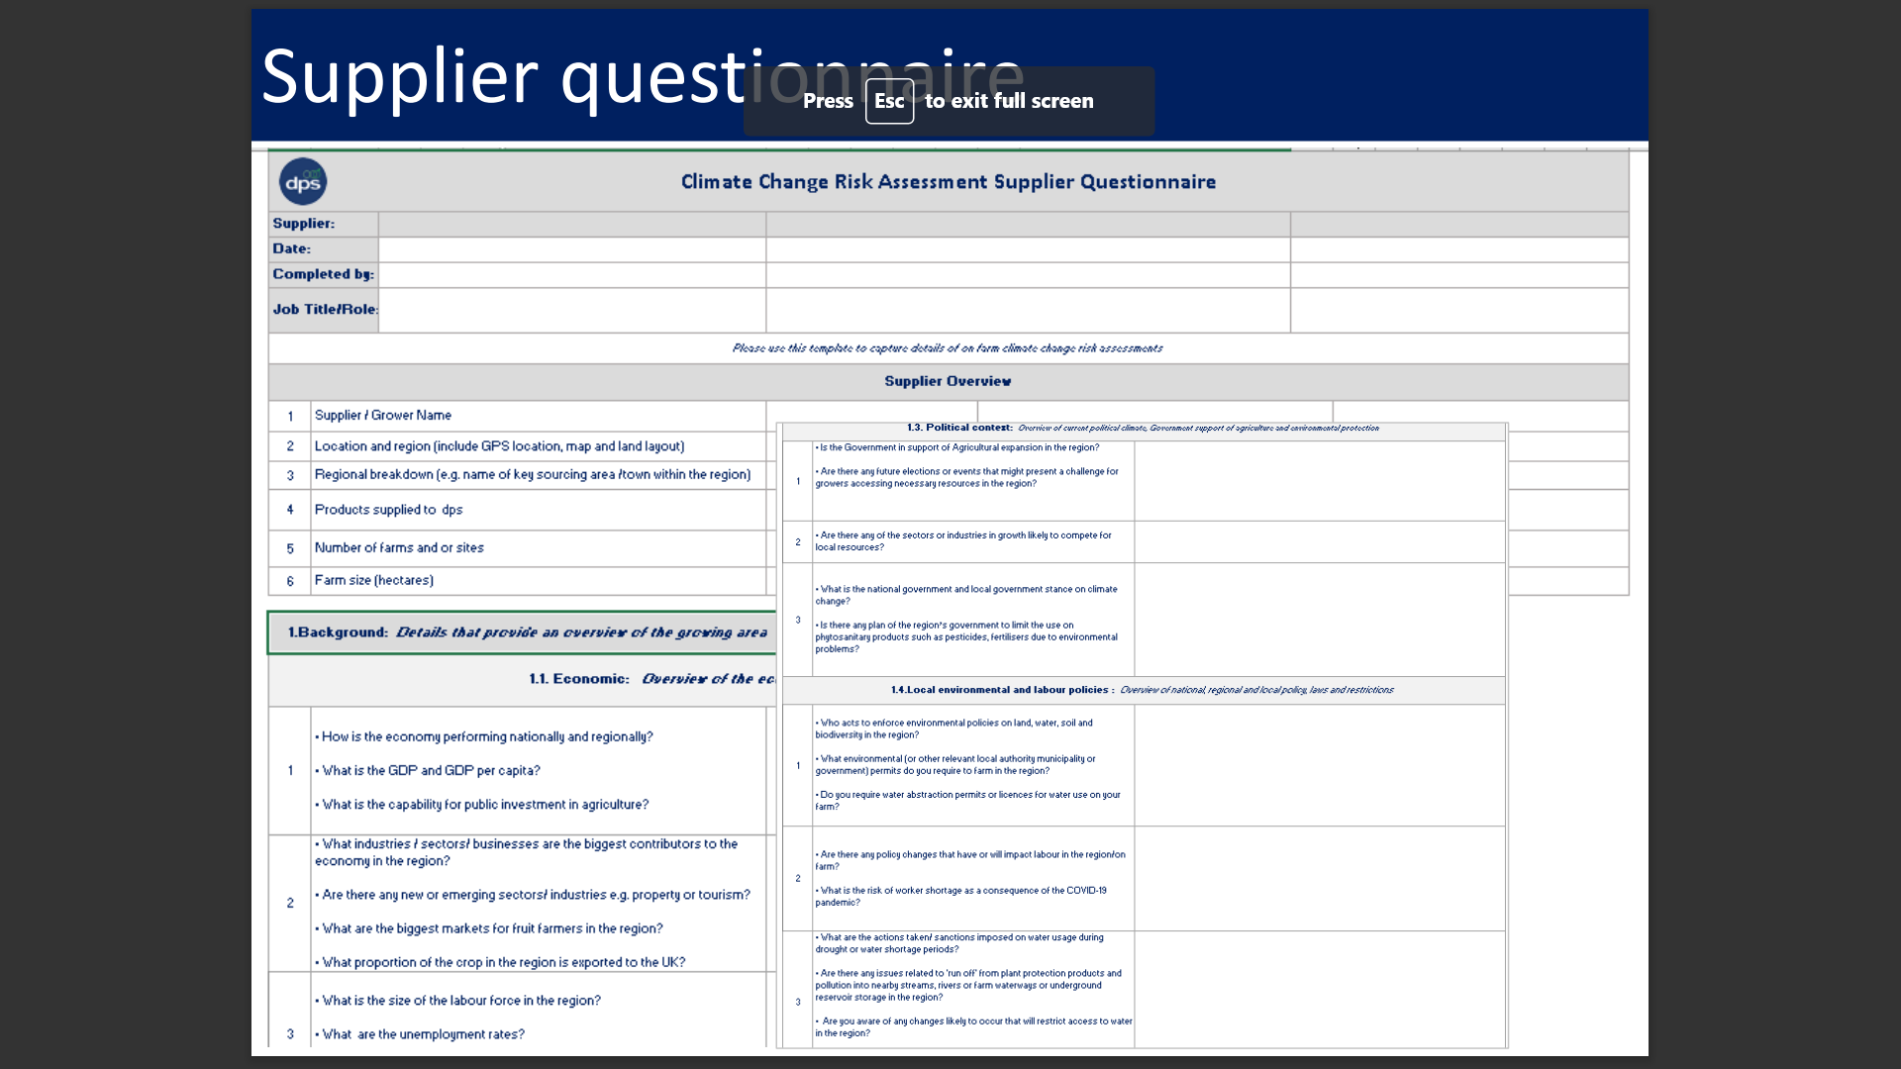

Slide 27
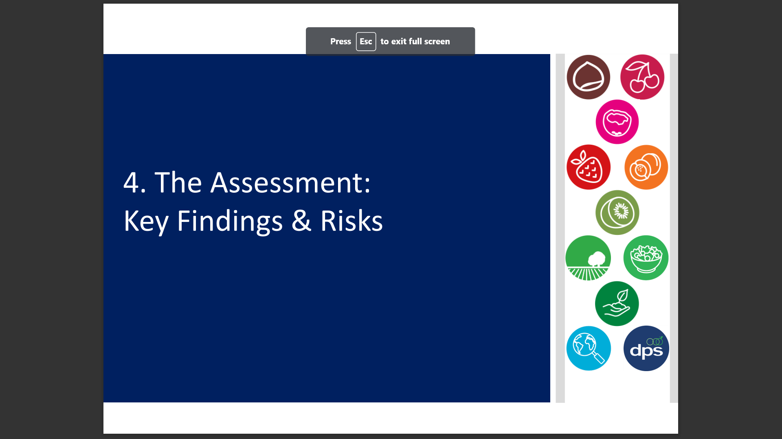

Slide 28
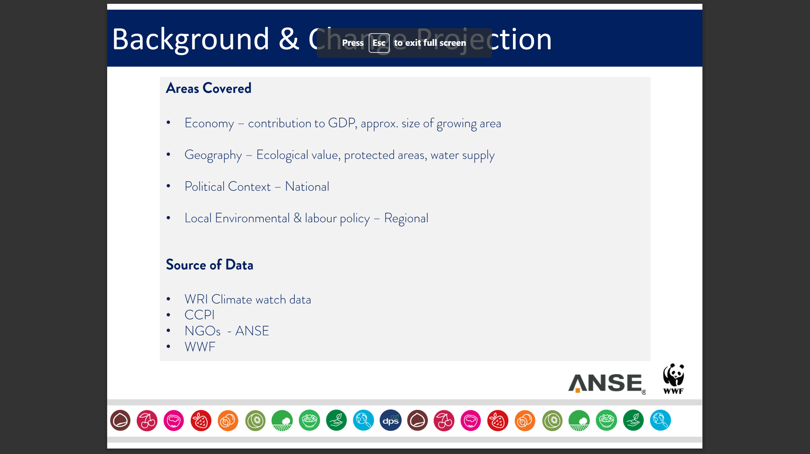

Slide 29
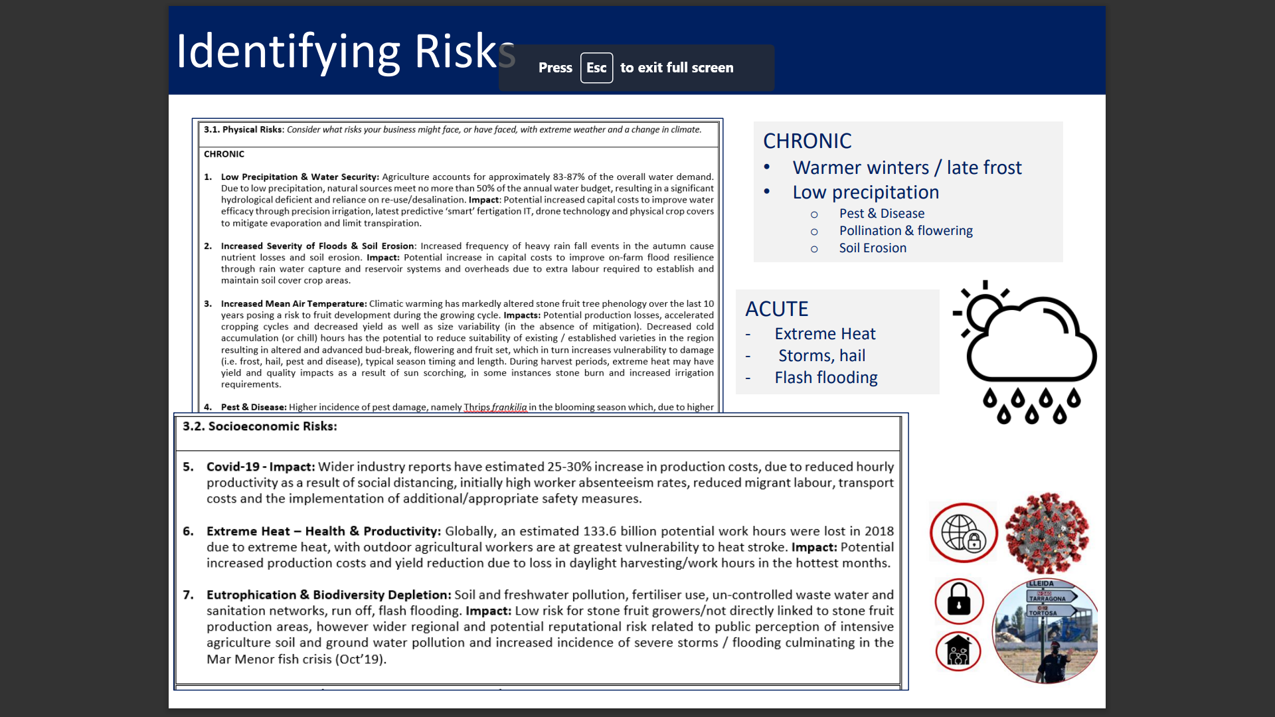

Slide 30
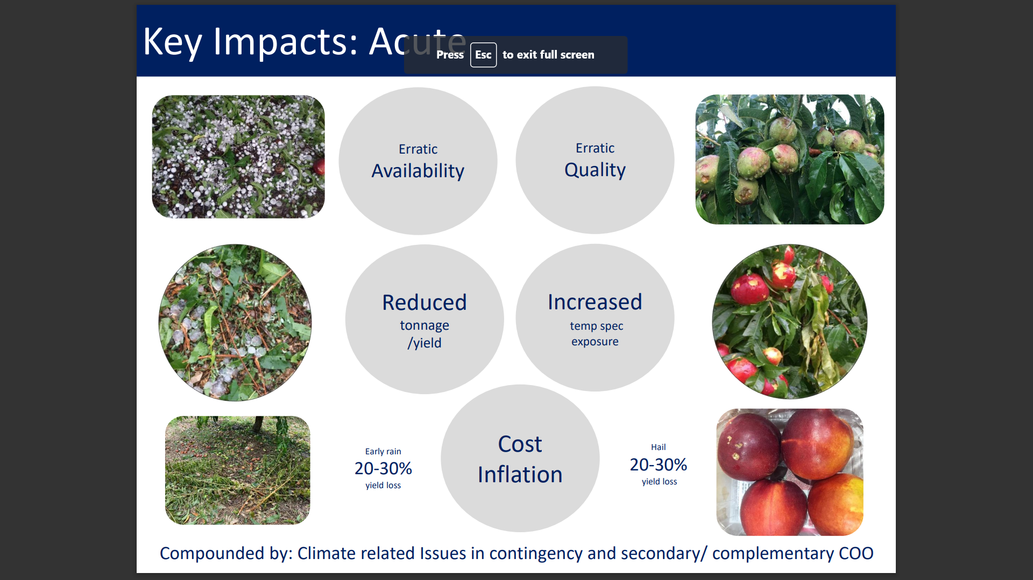

Slide 31
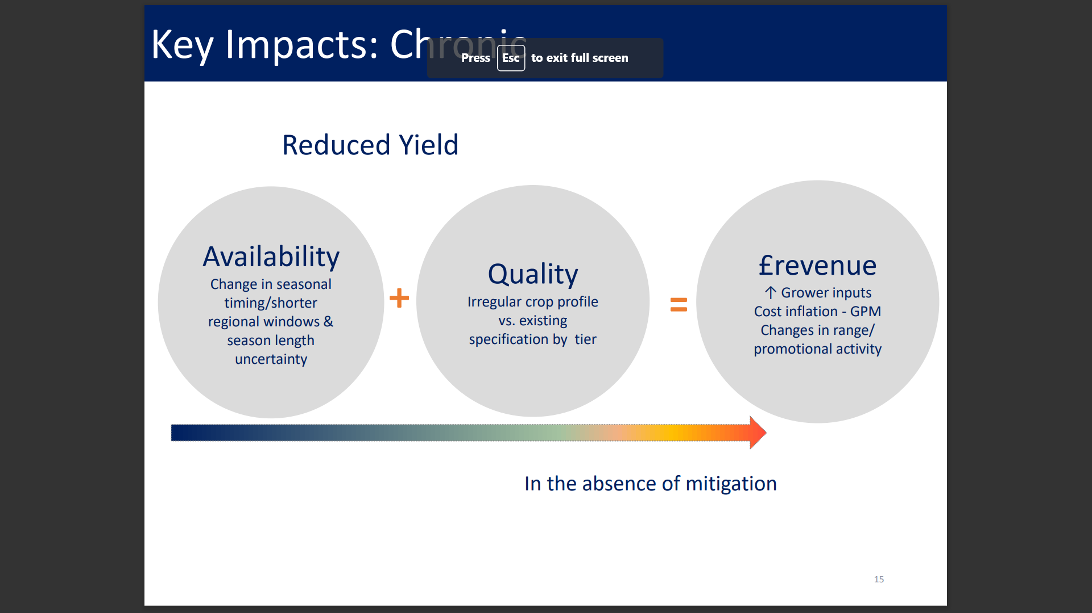

Slide 32
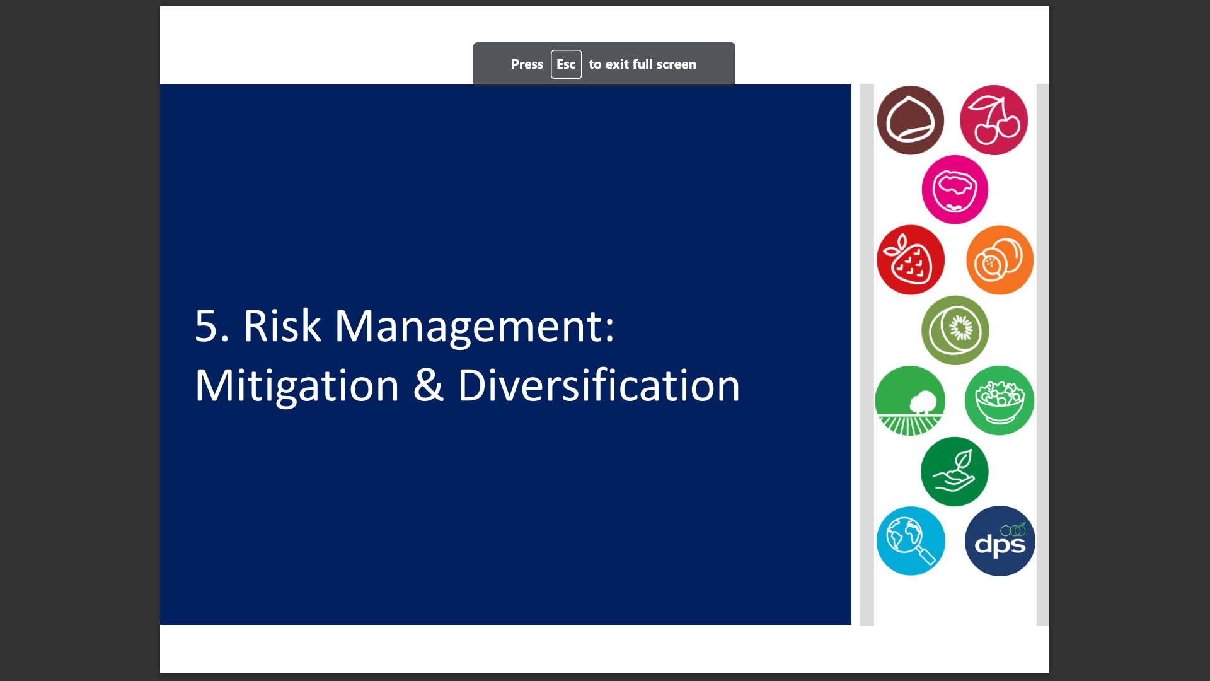

Slide 33
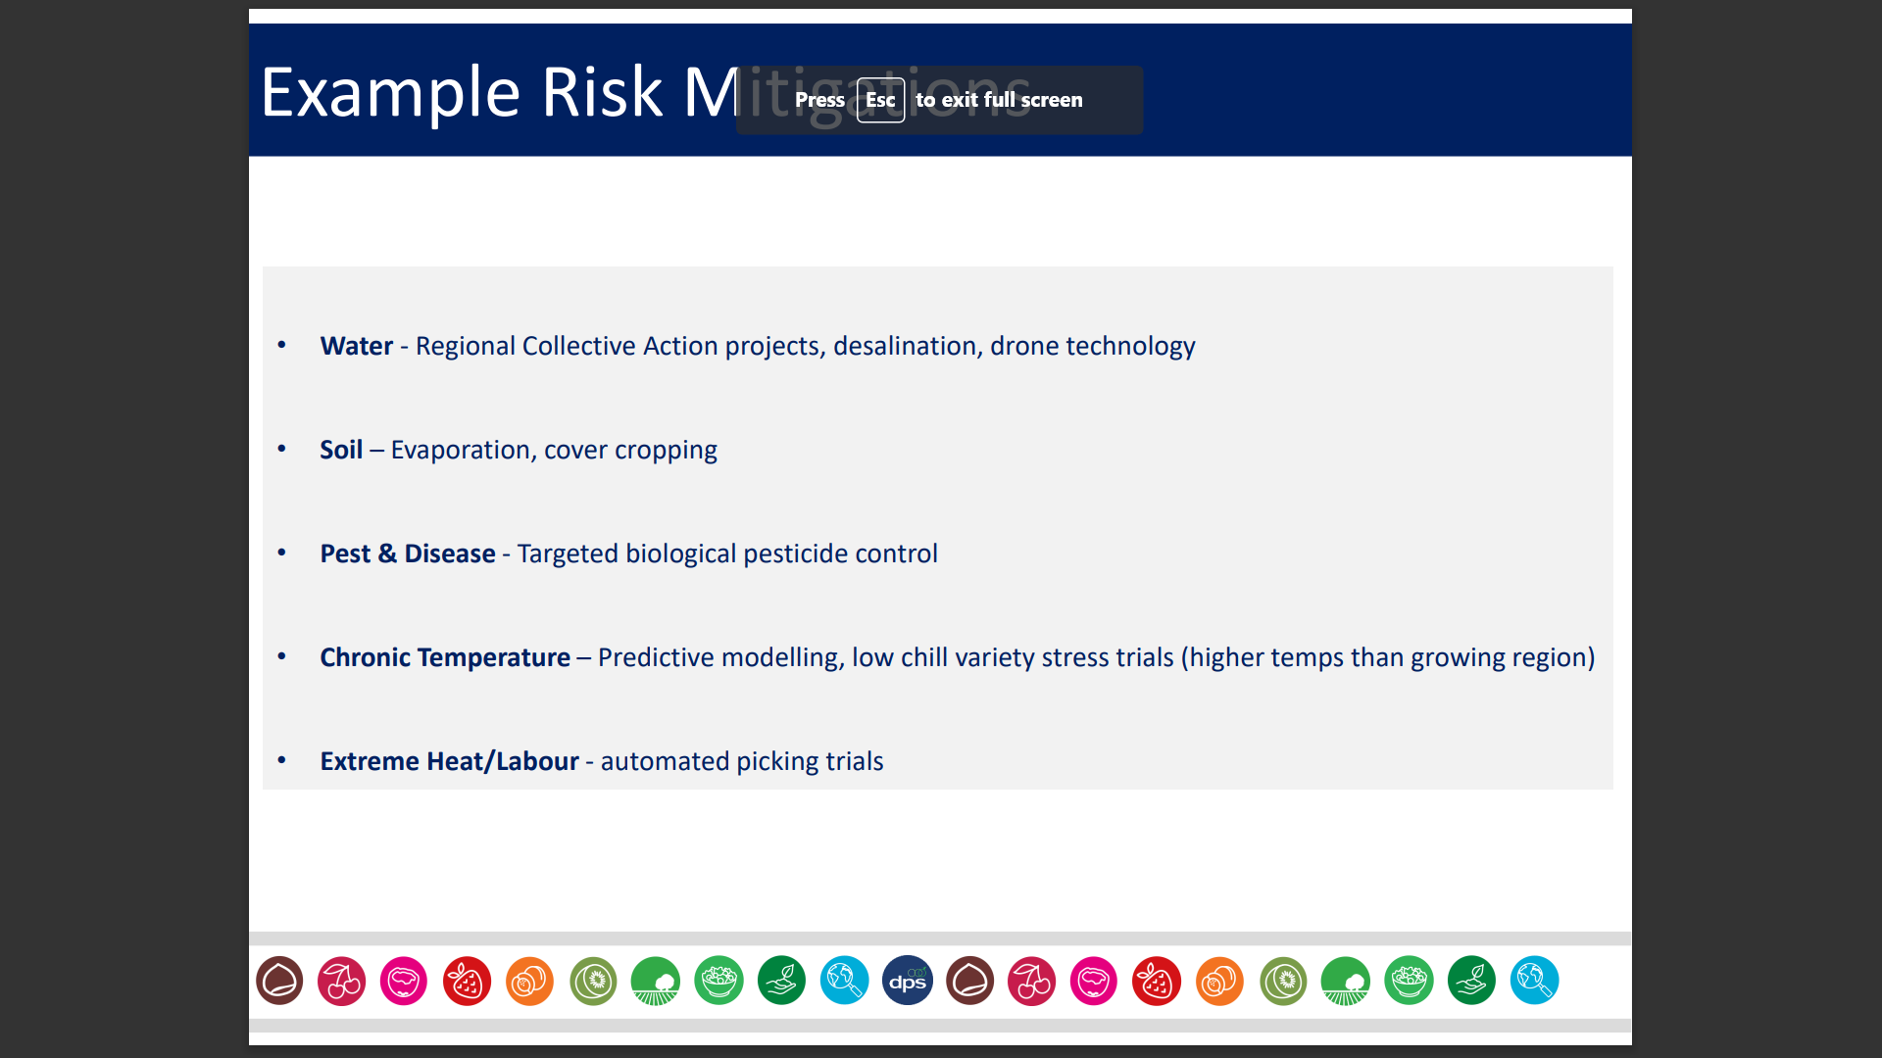

Slide 34
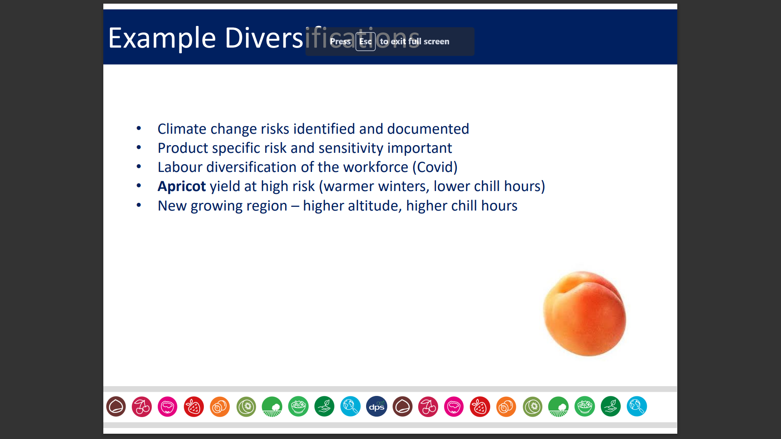

Slide 35
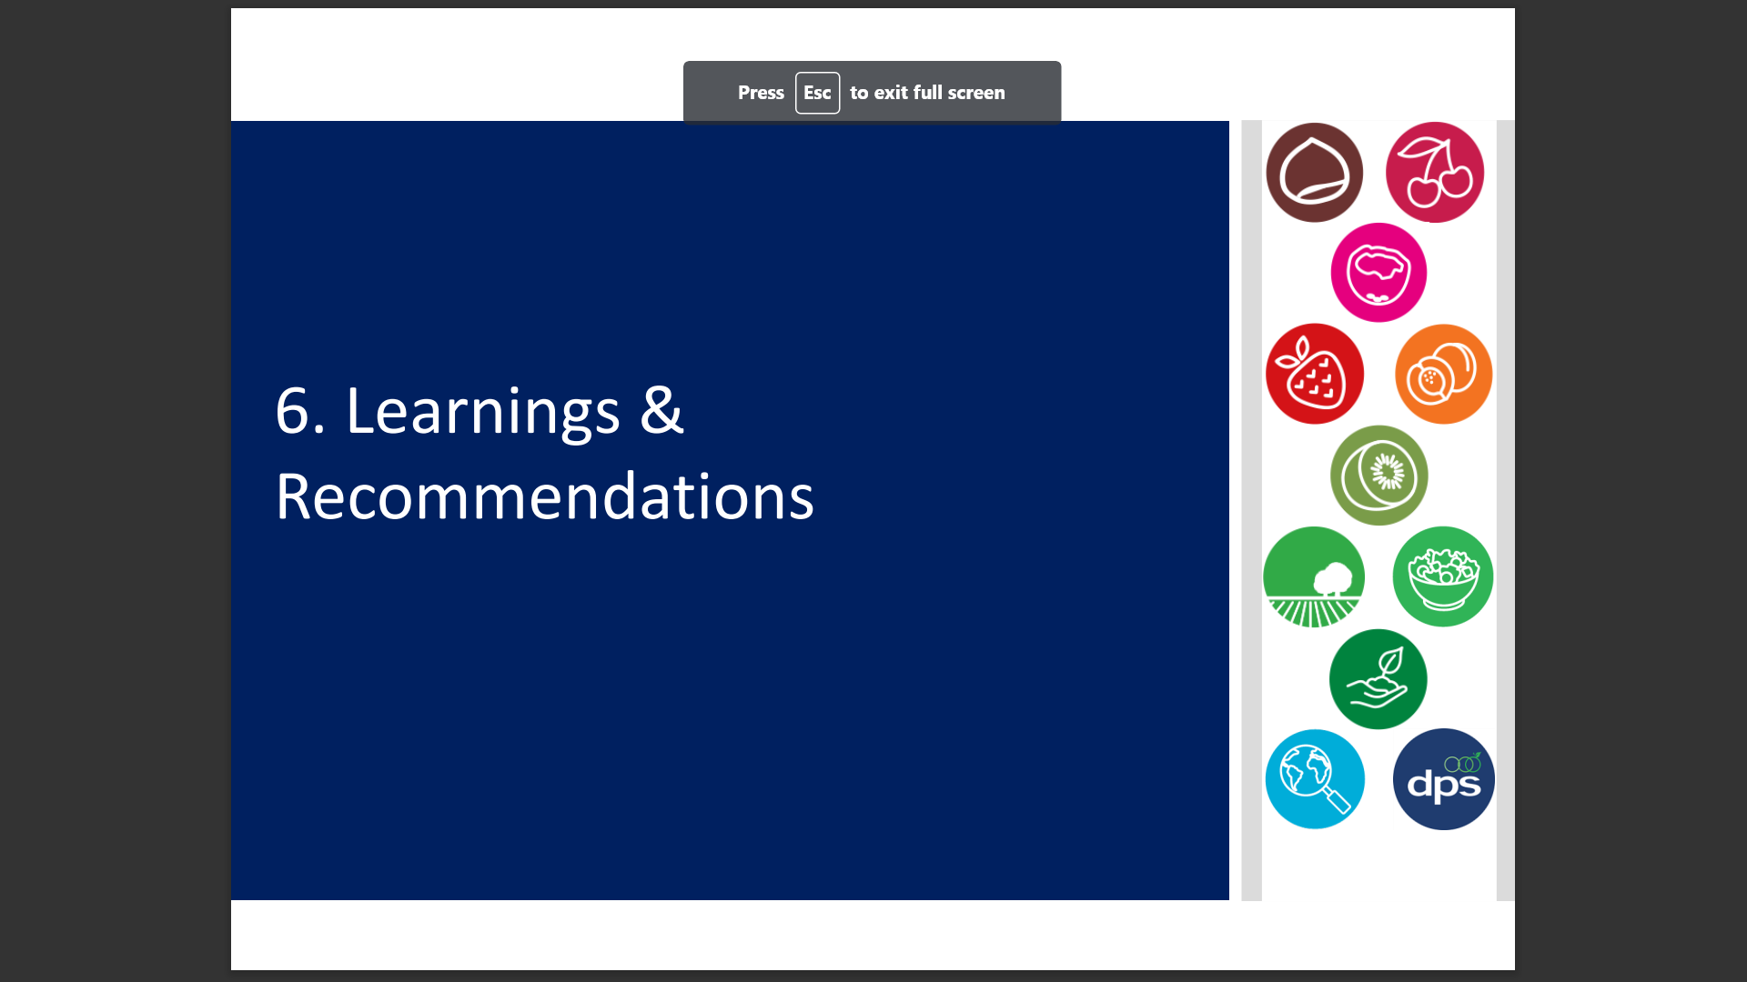

Slide 36
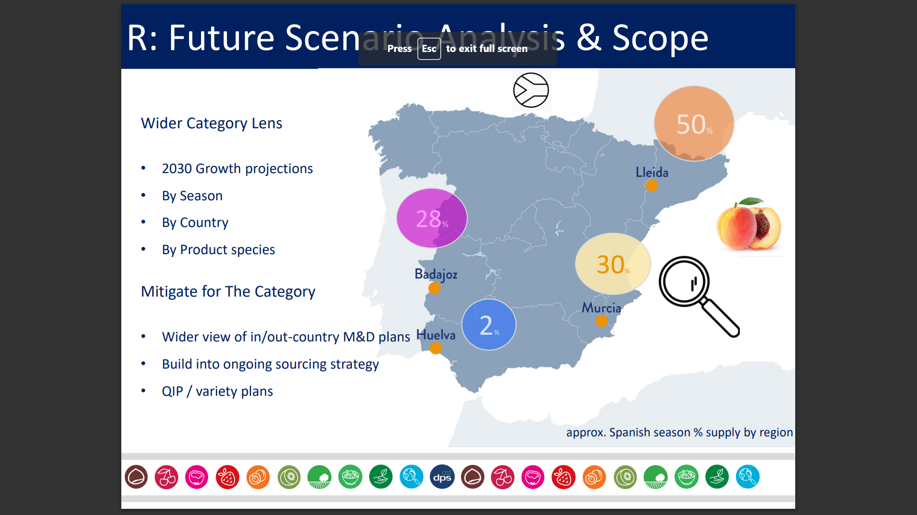

Slide 37
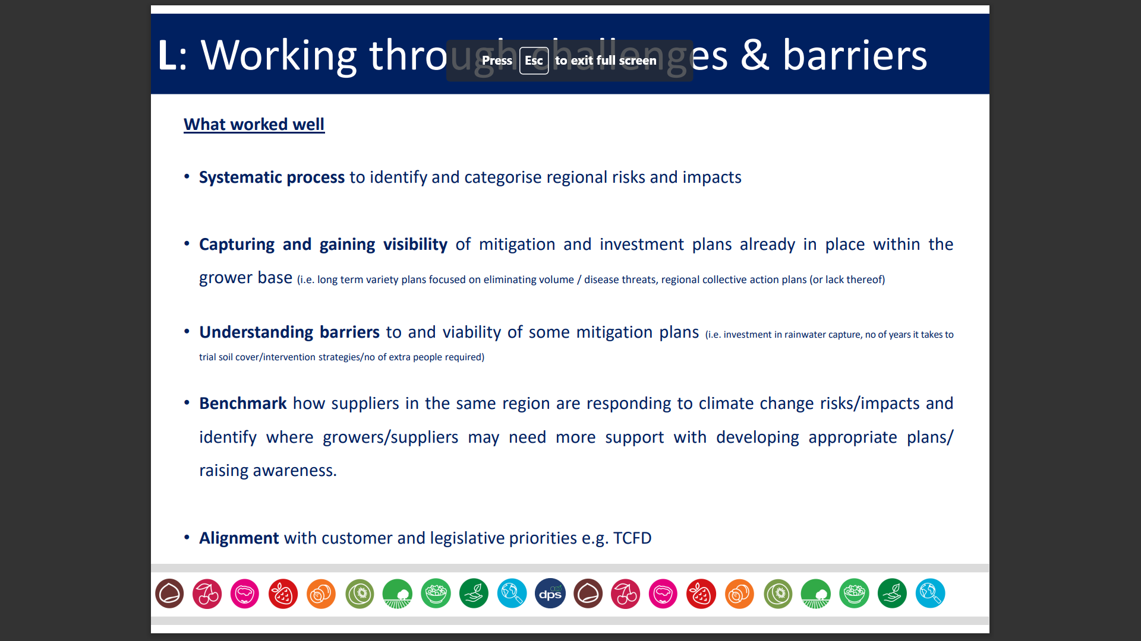

Slide 45
Q&A
Member expressed a wish for access to DPS’ methodology
DPS will update presentation and circulate. Happy to share data gathering form. Have since changed methodology to include Sedex Radar, WWF Water Filter
Member enquired into the balance of qualitative vs anecdotal data collected in DPS assessment.
DPS – more qualitative in trial, but has since become more quantitative.
Notes for future meetings; extend session time, focus theme – some ideas around nature-related financial disclosures & responsible exit strategies.
AP – FNET to circulate survey and next meeting date for diary.

