Slide 1
Ethical Trade
SEAFOOD
FNET 18/04/23 Louise McCafferty, Head of CSR

Slide 2










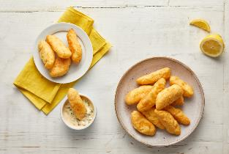
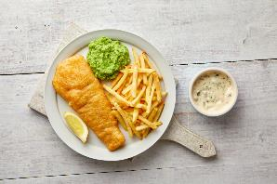
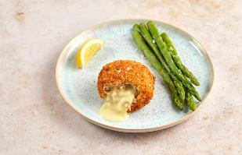
Joseph Robertson – what we do
Mixing
Forming
Coating
“Ready to Cook” (RTC) Ready Meal Manufacture
Operating 4 on 4 off shift pattern – 300 staff
65000 sq ft factory
c40 Direct suppliers / c 200 indirect links

Slide 3
What & Where are the human rights risks in our business?
Internal – direct recruitment, no agency, no Labour providers
      - annual Modern Slavery statement publicly available
– SMETA audit every 3 years
– Employee Voice Committee, H&S Committee, Whistleblowing helpline
- Recruitment Fees interviews
The ethical trade risks within our supply chain vary depending on
  the raw material – is it seafood, or meat? does it have palm oil in it, or soy?
  the location of the supplier – FNET and other country risk rating, on land or at sea?
  our relationship with them – how long it’s been in place – 28 years for some!

Slide 4
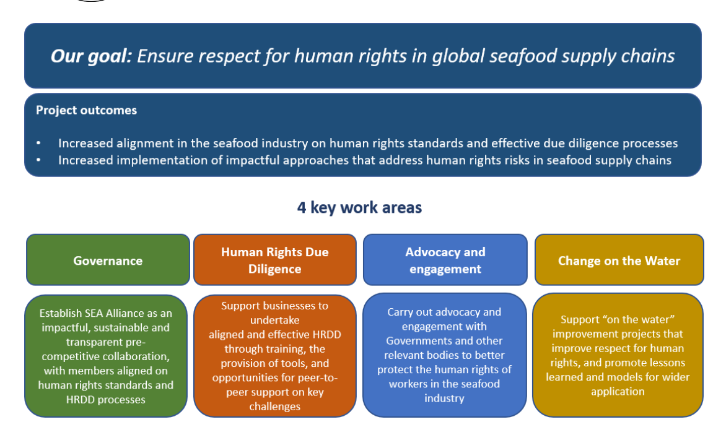
SEAA Seafood Ethics Action Alliance
  is a pre-competitive collaboration of retailers and seafood businesses aiming to strengthen human rights due diligence carried out in the global seafood supply chain, and ensure respect for human rights.
  April 2023 - 31 member companies, including the 11 largest UK supermarkets and leading seafood businesses and brands, alongside retail and industry trade bodies.
  The membership account for over 90% of UK grocery retail sales, and its members have global operations and supply chains.
SEAA How to Join

Slide 5

SSC – Sustainable Seafood Coalition
Steering group
Est 2011, working to ensure a healthy future for our oceans.
Vision is that all fish and seafood sold in the UK comes from ‘sustainable’ sources.
Helps to establish consistency on labeling and sourcing within the seafood supply chain.
Advocacy work, producing statements signed by members on issues of concern or support
Changes:
how to move from ‘environmental/conservation’ sustainability to the wider definition to include the other 2 pillars, ethical/social and governance/financial
More Info & How to Join the SSC

Slide 6
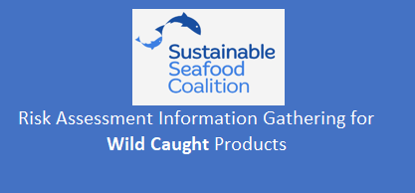
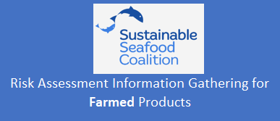
Seafood Risk Assessment
SEAA Seafood Risk Tool
This risk tool uses data from several indices and ratings systems to produce a high-level baseline assessment of human rights risks in selected fisheries. This is an updated version of the risk tool, first produced in 2020 for the SEA Alliance and contains a revised methodology, which has been amended at the request of the SEA Alliance, and an extended list of fisheries. The focus for assessment is human trafficking, forced labour, and child labour. The risk tool comprises eight indicators: 1. Fishery governance and stock health 2. Flag of convenience 3. Illegal, Unreported and Unregulated (IUU) fishing 4. Known risk of abuse in fisheries 5. Global Slavery Index Fishing Risk 6. Alignment with international standards for protecting workers 7. Food Network for Ethical Trade (FNET)'s Country risk rating 8. Gallup's Migrant Acceptance Index A set of rules are applied to each indicator, which are scored from 0 to 10. For each fishery, an average risk score has then been calculated from 0 to 10, where 0 equals higher risk and 10 equals lower risk. To sort the risk scores, use the sheet 'Fishery risk scores_Sort'. Globally, there is a higher risk of human and labor rights abuses occurring in fishing than in some other industries due to factors that include the difficult and dangerous nature of the work, the seasonal context within which fisheries often operate, and the difficulties of monitoring and enforcing labor rights at sea. Numerous other factors relating to the political, legal, socio-economic and environmental context in which a fishery operates, as well as differences at the individual supply chain level, contribute to the risk of human rights abuses occurring. This assessment is intended to represent the first step in a risk assessment process conducted by businesses and does not constitute a thorough analysis of all factors likely to contribute to risk. Businesses using this assessment should not make a claim of having carried out human rights due diligence based on the sole use of this assessment.
Additional social risk assessment criteria
Credible reports uncovering specific issues linked to aquaculture industry in this country?
Reports linked to IUU fishing for feed fisheries?
Reports linked to Modern Slavery?
Valid certification or third-party audit based on standard that includes the ETI code requirement present?
US Trafficking in Persons Tier ranking
SEDEX combined overall risk score
% migrant workers in the labour force
Has the fleet / facility engaged with an NGO to address labour risks?

Slide 7
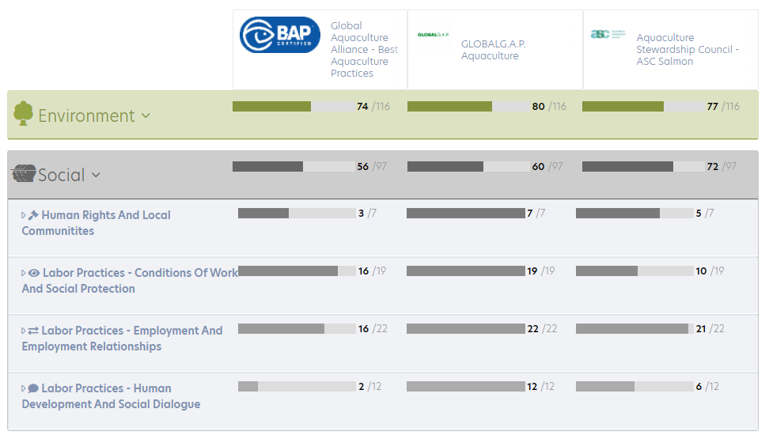

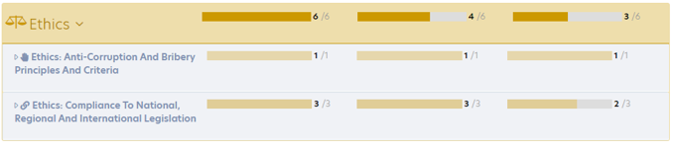

Sustainability Standards
social/ethical
MSC Labour Eligibility Requirements
Fishery Improvement Programmes - Social Responsibility

Slide 8
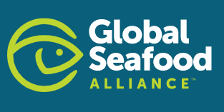
Vessels
Responsible Vessel Fishing Scheme
  Now in Revision 2
  Comprised of two core principles
    vessel management and safety systems;
    and crew rights, safety and wellbeing.
  underpinned by Work in Fishing Convention ILOc188 and other global conventions.
  The key objective is to enable fishing vessel operations to provide third party assurance of decent working conditions for the crew by demonstrating operational best practice from the catch to the quay, in line with internationally agreed protocols and guidelines.
  Now covers Seafood Processors
Worker Driven Social Responsibility – discussions about a pilot in UK seafood
  Labor Rights Initiatives Must Be Worker Driven:
  Obligations for Global Corporations Must Be Binding and Enforceable:
  Buyers Must Afford Suppliers the Financial Incentive and Capacity to Comply
  Consequences for Non-Compliant Suppliers Must Be Mandatory:
  Gains for Workers Must be Measurable and Timely
  Verification of Workplace Compliance Must Be Rigorous and Independent:
Seafish Ethical Common Language Group Worker Driven Social Responsibility – click link to register
SECLG How to get involved

