Slide 1

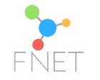
HRIA Review January 2023
FOOD NETWORK FOR ETHICAL TRADE – CONFIDENTIAL

Slide 2
Why companies complete a Human Rights Impact Assessment (HRIA)?
Builds knowledge and helps companies identify their most salient human rights impacts, which helps them to prioritize efforts to address them and manage material risks.
Responds to stakeholder expectations enabling them to evaluate companies’ human rights due diligence approach and assess a company’s progress over time.
Saves money in the longer run
HRIA's can help identify root causes and develop holistic solutions to complex issues
Can enhance internal and value chain cross- functional collaboration and ownership
Can strengthen stakeholder engagement, build trust and help enable access to remedy for rights holders (workers and neighbouring communities)

Slide 3
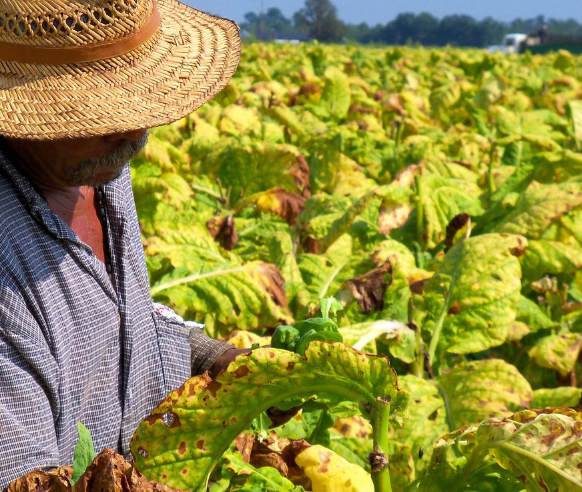
What is a human rights impact assessment?
A context specific process for identifying, understanding, assessing and addressing the adverse effects of a business project, activities or operations on the human rights enjoyment of impacted rights-holders such as workers, community members or consumers.
It is an elaborate assessment process.
Stand-alone exercise, but iterative follow up activities is essential to ensuring long term impacts.

Slide 4

Typical steps in a HRIA
Impact assessment to identify salient issues
Human rights mitigation action plan
Baseline analysis of gathered secondary information (e.g. national legal regulations)
Review of relevant business and supply chain activities and relationships
Scope of impacted human rights
Stakeholder engagement with the help of local consultants
Notes:
Review of relevant business and supply chain activities and relationships, Interviews with internal & external stakeholders (Buying, Corporate Responsibility, suppliers, stakeholders )
Contracting of experts with extensive knowledge of the sector to provide insight on the value chain context and conduct stakeholder interviews
Identification of a shortlist of potential rights impacted according to each business activity. Determination of a structure for impact assessment
Desk review of legal framework and existing situation and identification of underlying factors affecting enjoyment of rights
Mapping of key stakeholders, including those representing potentially impacted workers and communities. Issues and priorities for engagement need to be tailored to the stakeholders and rightsholders to ensure meaningful engagement.
Application of a methodology to determine saliency. Root cause analysis and determination of companies linkage. Identification of highest saliency impacts and company leverage to address them
Determination of appropriate actions to address impacts and Development of recommendations for Human Rights Action Plan

Slide 5
Different types of HRIA’s
Corporate level HRIA
Identifies areas of risk and opportunity across all operations
Informs the company’s broad human rights commitment and strategy
Identifies businesses, sites, products or markets for specific HRIA’s
Increases efficiencies by directing limited resources to where they matter most
Identify specific impacts, risks and opportunities
Determines prevention, mitigation and remediation plans for each issue
Can be done by individual companies or collaboratively
Country level HRIA
Product/raw material level HRIA
Site level HRIA
Community level HRIA
Notes:
Companies do not have to complete all assessment levels. Rather, each company should identify the levels that most effectively capture its human rights impacts, risks, and opportunities.
A corporate-level HRIA maps all of a company’s operations and functions against all human rights to identify key risks and opportunities and determine where a more specific, in-depth HRIA is needed at the country, site, or product level. A corporate-level HRIA also can highlight gaps in the current management system and provide a framework that the company can use to monitor its impacts over time.
A country-level HRIA typically builds on a corporate HRIA’s findings to understand and prioritize human rights issues at a country or market level. The goal of the country-level assessment is to identify and address specific concerns in operating countries. In many cases, this assessment informs a company’s decision about whether and how to enter a new market.
For many companies, the most significant human rights impacts, risks, and opportunities arise through the use of their products and services or in sourcing high risk raw materials. A product or service HRIA emphasizes a deep dive into understanding design processes, user communities, and the legal and human rights context in regions where the products are used.
A site-level HRIA is designed for a company seeking to identify and address human rights impacts, risks, and opportunities related to a specific operation with defined boundaries.
A community level HRIA championed by stakeholders like Oxfam allows affected communities to drive a process of information gathering and participation, framed by their own understanding of human rights. Communities can engage in solving human rights threats by working with NGOs, companies, and governments on a more equal footing. By starting with perspectives of affected people, the HRIA focuses on their concerns and their aspirations for human rights realization rather than risk to business.

Slide 6
How does a HRIA get to recommendations?
Salient impacts
Identify and describe actual and potential human rights risks and impacts
Consider current controls and efforts
What does the brand/retailer currently do to mitigate or contribute to those impacts?
Identify improvements and new approaches
How could these be changed / improved?
Effectiveness of existing controls
What can be learnt from best practice scalable solutions
What can be done to improve existing controls ?
Cocreate actionable recommendations
Build an understanding of the challenges and context from different stakeholder perspectives
Linkage to brand – individual or collaborative action?

Slide 7

Analysis to date : 24 HRIA
14 product categories
<15% are collaborative HRIA
50% HRIA have been completed by Ergon
Over 60% of HRIA’s have been completed in last 2 years
Average length 6-12 months
More than 50% HRIA have detailed reports with timebound actions
Only 3 FNET members filled in the excel spreadsheet so couldn’t verify average cost but determined by scope, complexity and scale of stakeholders engaged

Slide 8

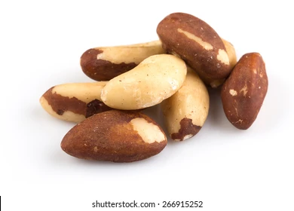
Analysis to date:
3 HRIA have collaborative partners
No | Product | Country | Brand | Implementation partner | Published
2 | Citrus | Spain Morocco | Aldi Nord Coop Sweden | Ergon Oxfam | 2022 HRIA report 2022 HRIA report
3 | Coffee | Brazil Brazil Peru | Aldi South Morrisons Morrisons | Ergon Ergon Ergon | 2022 HRIA report TBC 2023 TBC 2023
1 | Avocado | Peru | Aldi South | Ergon | 2022 HRIA report
2 | Brazil nuts Hazelnuts | Bolivia Turkey | Aldi South Unilever | Ergon Shift/Impactt | 2022 HRIA report 2021 HRIA summary
2 | Tea | India Kenya | Aldi South Lidl | Ergon Ergon | TBC 2023 2020 HRIA report
1 | Tuna | East pacific & Indian ocean | Aldi Nord | Ergon | 2021 HRIA report
2 | Banana | Belize, Colombia, Costa Rica, Dominican Republic, Honduras Columbia | Fyfes Lidl | BSR Ergon | Summary in 2019/2020 Sustainability report 2021 HRIA report
2 | Berry | Spain Spain | Lidl M&S & Fresca | Ergon | 2020 HRIA report TBC 2023
1 | Beans & Pulses | Argentina | Princes | Ergon | TBC 2023
2 | Prawns | Vietnam Thailand Vietnam | Tesco Unilever Coop, Sainsburys, Lyons seafood | Impactt Shift/Impactt | 2021 HRIA report 2021 HRIA summary
1 | Pork and Lamb | UK | Pilgrims, Waitrose & Coop | Impactt | TBC 2023
2 | Processed Tomatoes | Italy Italy | SOK Corporation CBL Dutch Food Retail Association/ Lidl | Oxfam ImpactBuying bv | 2019 HRIA report 2022 HRIA report
2 | Wine | Italy South Africa | Systembolaget AB Ahold delahaize | Oxfam ICCO | 2021 HRIA report 2021 HRIA report
1 | Palm oil | Indonesia | Nestle | DIHR/TFT | 2018 HRIA report Nestle HRIA summary report
1
1
1

Slide 9
What are some of the new insights found?
Informality
Issues relating to contracts
Excessive working hours
Low and /underpaid wages
Anti union activity by employers
Direct and indirect gender discrimination
Serious health implications
Lack of available and accessible grievance mechanisms
Forced labour
Negative impacts on the right to life, liberty and security
Poorly maintained and / or inadequate housing and sanitation
Notes:
Informality – which can increase workers’ vulnerability to abuses and limit recourse to remedy (i.e. through membership of unions or access to grievance mechanisms);
Issues relating to contracts – including for example, lack of written contracts and prevalence of temporary / seasonal contracts which can leave workers vulnerable to coercion from managers;
Excessive hours – for example, hours above the legal maximum during harvest; or workers engaged for up to 20 hours without a break on fishing vessels;
Low and / or underpaid wages, including manipulation / abuse of piece rate systems by employers (a notable exception is bananas, where wages are high compared to other sectors and reportedly close to a living wage for workers covered by the main CBA);
Anti-union activity by employers, including discrimination, coercion and threats;
Direct and indirect gender discrimination, in the form of occupational gender segregation, with women concentrated in lower-status, lower-paid roles; discrimination in pay and hiring and widespread gender-based violence and harassment (GBVH);
Serious health implications (for workers, smallholders and communities) associated with spraying of pesticides and agro-chemicals, often without adequate protective equipment and / or training;
Forced labour – (fish) with exploitative recruitment practices (passport confiscation, excessive recruitment fees and other costs, misinformation / misleading migrants from understanding their rights and employment terms) reported in relation to migrant workers;
Negative impacts on the right to life, liberty and security (fish) – with dangerous working conditions leading to occupational fatalities, reports of possible deaths and disappearances;
A lack of available and accessible mechanisms for grievance and remedy at both worker and community level;
Poorly maintained and / or inadequate housing and sanitation – substandard, overcrowded housing and lack of access to water and sanitation.

Slide 10
Root Causes
Weak labour market
Poor regulatory framework and enforcement
Embeded social norms
Length and complexity of many supply chains
Certification benefits not realised
New pests & disease result unpredictable yield and earnings
Volatile prices/ doesn’t cover
Cost of production
Climate change
Labour shortages
Buying practices
Notes:
The impacts identified usually relate to underlying factors (root causes) such as weak labour markets, poor regulatory frameworks, and embedded societal norms. However, the buying practices of actors within the supply chains, as well as limited monitoring and implementation of their standards, can contribute to impacts.
The prices received by producers can be highly volatile and, driven by competitive pressures, often do not keep pace with the costs of production.
The potential of certification schemes to drive positive change is not always fully realised and the additional costs can be onerous
Climate change is already having a significant effect on production
Crop diseases (not climate-related) are a problem in the banana and citrus supply chains – leading to unpredictable yields, with a consequent impact on producer earnings.
Labour shortages can be acute challenge. In fish, ports and fleets reported labour shortages, especially following COVID-19. In coffee, the ongoing increase in migration from rural to urban areas, combined with a perception that coffee harvesting is physically challenging, make availability of labour an ongoing problem for producers

Slide 11
What are the typical types of recommendations
Enable systemic change
Housing
Enhanced Due Diligence
Policies and SOP’s
Supplier selection
Evaluate performance in tendering
Health and safety
Living wages and incomes
Benchmarking
Pricing and Purchasing Practices
Road safety
Collaboration
Grievances
Risk assessment
Source
direct
Shorten supply chain
Make it easier for key actors to engage
Increase leverage at lower tiers
Sectorial initiatives
Governance
Security
Transparency
Prevention
Certification
Supplier awareness of HRIA
Pricing and Purchasing Practices
Strategic sourcing
Supply chain monitoring
Realtime
Social Dialogue
Advocacy
Gender Strategy
Communications
Consumer engagement to inform purchasing
Gender equality & empowerment
Focused on vulnerability & saliency
Stakeholder engagement
Longer term contracts
Fair price and incentives
Certification
Union engagement
Marketing policies/SOP
Worker rights awareness
Gender Data requirements
Gender programmes

Slide 12
Lessons learnt (so far but would like more FNET member input)
Scope is often determined by budget but can be helpful to ensure assessment is focused
HRIA’s are not audits. The human rights considered are more comprehensive which helps companies uncover more areas for improvement
The methodology needs to be adapted to ensure delivers clients needs and to the context of the assessment
At outset be clear on interaction and timelines expected between partners and final outcomes
Engaging key stakeholders can be time consuming, particularly government and local Community vulnerable rights holders.
Leverage to implement recommendations can be a challenge – collaborating with others can/does overcome this?

