Slide 1
Risk Assessment & Mitigation Meeting
The Food Network for Ethical Trade – 24th March 2021

Slide 2
Attendees & recording information
Aisha Aswani – Co-op
Andy York – Pilgrim
Catherine Russell – Angus Soft Fruits
Christina Bosworth - Keelings
David Alder - MWW
Elenor Smith – Aldi
Fiona McKerrow – Total World Fresh
Frankie O’Byrne – Morrisons
Hella Lipper – Blue Skies
Ian Burgess – Bakkavor
Imogen Wright – Lidl
James Salisbury – Ocado
Louise Herring - HCL
Louise McCafferty – Joseph Robertson
Naomi Kirkwood – Samworth Brothers
Rick Fletcher – Greencore
Solenne De Durand - innocent
Susan Sellar – DPS
Victoria Dodman – M&S
Topic: Risk Assessment and Mitigation Working Group Meeting – focus on Mitigation with working case studies from Xinjiang/ Turkey/ Spain/ Italy
Start Time : Mar 24, 2021 10:51 AM
Meeting Recording:
https://us02web.zoom.us/rec/share/1ETyBpTVl4Y4CYZPC0_SyqWDcGkCUV7tkGx68q53F9dcVYCr7KzzNhqRa5kYF6g.4kaaxQuDDUHxdgnx
Access Passcode: +r75t&Tn
2
Notes:
1000-1010

Slide 3
Agenda
Introductions and reminder of previous meetings – 5 mins
Emerging risks - 15-20 minutes allowing for discussion. UK/ Turkey/ China/ South Africa/ India
Working cases studies of members’ mitigation of risks – 30 minutes
  David Alder – Minor Weir and Willis – prison labour, Zimbabwe
  Ian Burgess – Bakkavor – produce supply chains, Italy
  Vicky Dodman, M&S - migrant worker risk management, Turkey
Group discussion – questions and answers, common principles, lessons learned, ongoing challenges – 25 minutes
Update on sharing RA presentation with suppliers – 5 mins
Wrap up, date and agenda for next meeting – 10 minutes.
3

Slide 4
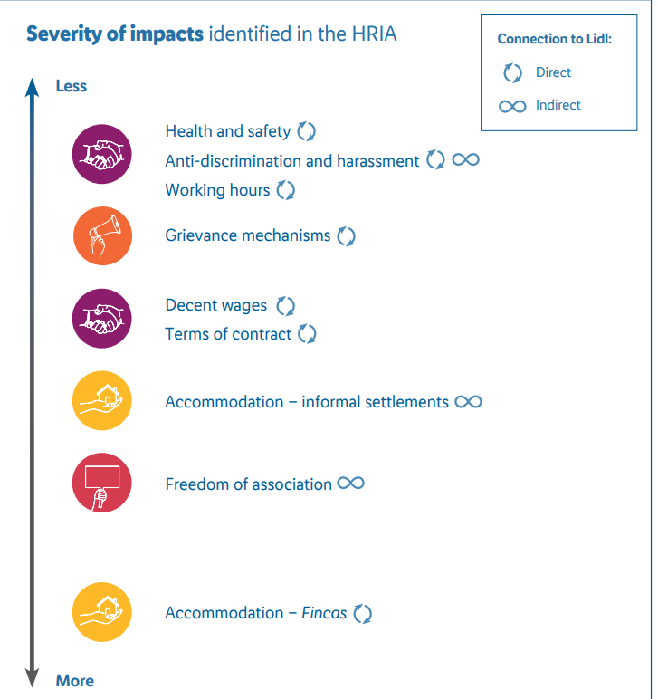
Last meeting – 15th October
Due diligence discussions
Varying views on the value of the new Sedex Radar tool – follow up session arranged with Sedex 16th December
Increased uptake of remote audits
Increased use of worker voice technology
Rollout of human rights impact assessments
Any further member input?
Current retailer views on due diligence?
Risks discussed:
UK – rising immigration crime – trend has increased in early 2021
Ongoing impact of Covid in UK production sites – decline in available hours leading to workers being lured to other jobs where work may be more exploitative
Malaysia and forced labour allegations - RSPO response on palm oil – FNET followed up with RSPO and the Retailer Palm Oil Group and there was openness to discussion – what specific points would members want raised?
Subsequent developments with Sime Darby and US Withhold Release Order
Spanish Berry HRIA - Lidl Great Britain
CONFIDENTIAL – NOT FOR DISTRIBUTION

Slide 5
Emerging risks
UK – immigration rule changes/ Brexit/ recruitment fees/ anti-protest bill
Turkey – erosion of human rights/ freedom of expression/ freedom of assembly/ withdrawal from accord to protect women’s rights
China – Uyghur minority forced labour in Xinjiang/ Tibet/ Inner Mongolia/ international sanctions
South Africa – rising unemployment/ food poverty
India - increased pressure on human rights organisations/ intimidation of journalists and activists/ attacks against Muslims
5

Slide 6
UK – emerging risks & implications
Emerging risks
Brexit and immigration rule changes – potential increased risks of labour exploitation as a result of reduce labour availability
Flex report (March 2021) into the Seasonal Workers Pilot highlighting:
  Unfree recruitment – 62% of workers incurred debts to travel/ discrepancies in work offered vs reality
  Work and life under duress - 66% of Seasonal Worker Visa (SWV) workers reported receiving threats of loss of work and 17% reported threats of deportation from their employer. Unsafe housing, zero hour contracts
  Refusal of transfers to alternative employment – 62% refused alternative employment + risks of homeless and deportation results in inability to terminate contract
Police, Crime, Sentencing and Courts Bill.
Implications
Increased risk of exploited labour in agriculture, food processing and other industries?
Flex report recommends:
  Ensuring employment contracts are shared with SWV workers in country of origin
  Removing visa fee of £244
  Ensure SWV workers are guaranteed minimum income of £332.50 per week for 35 contracted hours
  Clear transfer pathway
  Complaints mechanism for SWV workers
?
6

Slide 7
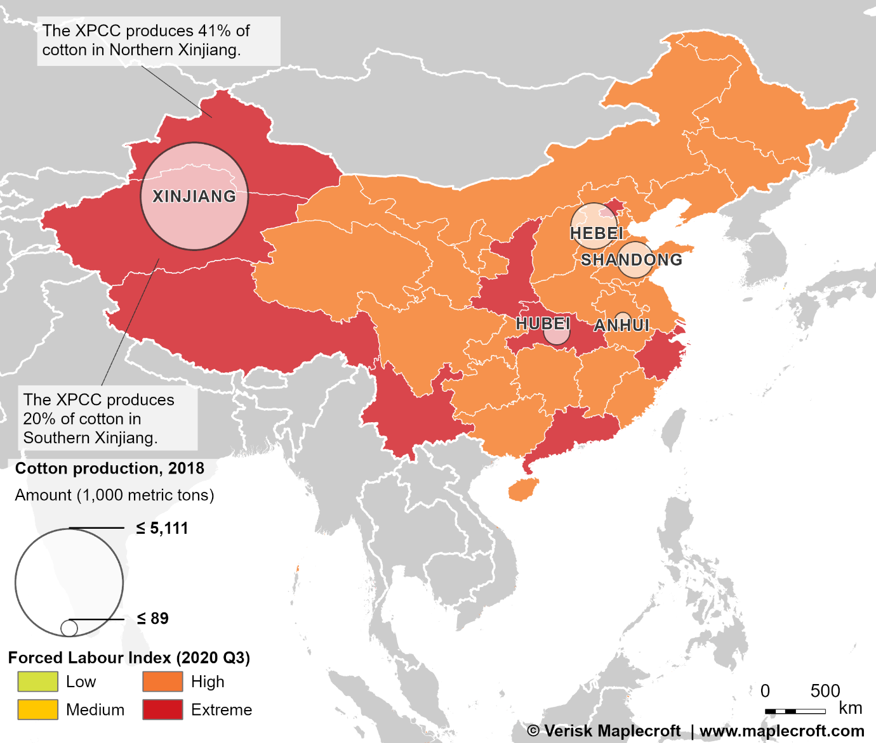
China – emerging risks & implications
Emerging risks
Uyghur minority forced labour in Xinjiang – multiple sources defining China’s actions as “genocide”/ 1,000s of Muslins from Uyghur monitory working under forced labour conditions
Tibet – alleged 500,000 Tibetan farmers in forced labour camps
Implications
ETI and Uyghur Call for Action calling for companies to cease sourcing from Xinjiang – view that no due diligence is sufficient to mitigate risk
FNET list of products sourced from the region indicates production in Xinjiang covers wide range of products/ ingredients from food to clothing and IT
What are the implications of ceasing to source from a region/ country for workers?
What are the implications for your business/ any colleagues in China?
What are the longer-term implications for sourcing from China?
Inner Mongolia – US says it has conclusive evidence of forced labour links to sweeteners (Stevia)
International sanctions – US Withhold Orders and Sanctions placed on Chinese officials by US, EU, UK and Canada.
US bans China sweetener products, claiming breach of forced labour law (yahoo.com)
China reportedly forced 500K Tibetan farmers into labor camps (nypost.com)
https://www.maplecroft.com/insights/analysis/xinjiang-sanctions-disrupt-global-apparel-supply-chain/
https://newlinesinstitute.org/wp-content/uploads/Chinas-Breaches-of-the-GC3.pdf
7

Slide 8
Turkey – emerging risks & implications
Emerging risks
Erosion of human rights – situation has worsened since state of Emergency in 2016 - executive control and political influence over the judiciary/ new las introduced to restrict financing of civil society and internet freedoms
Freedom of expression – hundreds of opposition politicians, journalists, human rights defenders, lawyers, academics and other civil society actors detained and prosecuted under anti-terrorism laws
Freedom of assembly – blanket bans and use of excessive force against protestors + investigations into online peaceful dissent
Withdrawal from Istanbul Convention to protect women’s rights
Systematic discrimination against Kurds, ethnic minorities and refugees
Human rights action plan published March 2021
Implications
According to Unison, trade union rights severely restricted & workers are routinely denied their right to strike. ITUC named Turkey in top 10 worst countries for workers
Women workers in particular face high levels of discrimination – higher unemployment rates/ lack of access to formal or higher paid work
What does this mean for members’ due diligence?
Do you know if your sites have trade unions/ committees? How are members protected?
Gender breakdown of workforce and audit findings on harassment and discrimination
https://www.tuc.org.uk/research-analysis/reports/worsening-situation-workers-turkey
https://www.unison.org.uk/content/uploads/2018/12/25370_Workers_rights_Turkey_REPORT_OV.pdf
Joint Letter to HRVP Borrell on EU-Turkey Relations | Human Rights Watch (hrw.org)
8

Slide 9
India – labour law changes and implications
Emerging risks
New labour codes – Indian government has consolidated existing laws into 4 new codes – enforcement likely in May:
  Wages Code - applicability for all employees (departure from previous laws)/ floor wage introduced for each region
  Social Security Code – applies to formal & informal sectors
  Industrial Relations Code – primarily applies to workers not in managerial capacity/ new code allows recognition of any union as a “negotiating union” in an industrial establishment if it receives approval of 51% workers or more
  OSH Codes – apply to all categories of employers (previously only covered workers)
Implications
Compliance with the laws will be simpler and cheaper
Wages now have a uniform definition and uniform eligibility criteria – could increase benefits payments
Floor wage introduction – meant to drive standardisation in wages - current system sets minimum wage by role/ skill level
Overtime now requires consent
Contracts now required for all workers
It will be easier to restructure workforces – threshold now 300
Paid leave requirement has reduced from 240 days to 180 days
Welfare facilities now required for contract workers
Social security schemes for gig workers and “platform” workers
Sites less likely to be able to have multiple trade unions on site
Lack of worker & trade union consultation.
https://www.amfori.org/sites/default/files/Labour%20Code%20-%20amfori.pdf
9

Slide 10
India – emerging risks & implications
Emerging risks
Agricultural law changes – strikes still going on about the Farm Reform Bills – intended to break monopoly of government and deregulate wholesale trading, provide legal framework for farmers to enter into contracts and dispute mechanism. Impact:
  Middlemen will be affected
  Farmers fear it will remove minimum support that’s existed since 1967
  Farmers fear lack of bargaining power with private companies
  No grievance mechanism for farmers
“Partly Free” – India’s status declined from Free to Partly Free in the 2021 Freedom in World index due to anti-Muslim activities, pressure on human rights organisations, attacks on press freedoms and restrictions on migrant worker during Covid
Gender-based violence and harassment widespread
Implications
Potential for farmers’ income to be reduced – farmer suicides already high in India
Small farmers could be pushed out of production – small farmers disadvantaged by current scheme
Impact on workers on small farms – loss of employment/ instability of employment
Advantages - commercialisation of Indian agriculture leading to efficiencies and more job opportunities
What does this mean for members’ due diligence? At farm level?
What does it mean for diversity on sites/ farms?
Gender breakdown of workforce and audit findings on harassment and discrimination
10

Slide 11
South Africa – emerging risks & implications
Emerging risks
Rising unemployment and immigration –
  South Africa’s unemployment rate is now 32.5% – its highest point since Quarterly Labour Force Survey started
  Increased evictions of workers and increased use of migrant labour on farms
  Potential new law to be introduced to curb use of migrant labour
Food poverty –
  Research indicates food prices have climbed over lockdown, latest budget effectively cut grants (e.g. child support) and raised NMW wage by too little
  Basket of core foods has increased above inflation (5.6%)
  Fuel prices increasing by 27 cents per litre
  Electricity tariffs going up by 15.6%
  Food prices expected to rise by as much as 10%
  Minister of Employment and Labour announced 4.5% increase in minimum wage in February – farm workers will now earn full minimum wage.
Implications
Wage costs will be going up for suppliers
How will farms dependent on migrant labour source workers?
Cost of living going up for workers
Are you picking up tensions with cost of production from suppliers? Who is covering national minimum wage increases?
Are audits/ other methodologies picking up cost of living challenges?
Are there increased risks of exploitation because of rising unemployment?
11

Slide 12
Myanmar – emerging risks & implications
Emerging risks – source of rice and rice flour
Ongoing protests following military coup two months ago –
  Top UN officials condemn killing of more than 100 people on Sunday 28th March in latest police response to civilian protests
Impact on workers -
  ILO Director General has called on military to respect freedom of association following reports of intimidation and threats against workers and trade unionists peacefully protesting for the restoration of civilian rule
  Myanmar garment workers have called for support of international brands for workers intimidated or laid off for participating in protests
  Primark supplier accused of locking workers in factory to stop them taking part in protests
Financial/ political implications -
  Risk of Myanmar becoming a failed state with economy collapsing due to protests - potential to spill over into neighbouring countries including Thailand
  Thousands flee into Thailand following airstrikes over weekend of 27th/ 28th March
Implications
Inability to guarantee workers’ freedoms Long-term economic damage and increase in poverty
Are you sourcing directly/ indirectly from Myanmar?
What information is being shared with you by suppliers about the protests? How can you verify this information?
How are workers in your supply chain being impacted?
Are your suppliers restricting workers’ ability to take part in protests?
12

Slide 13
Ethiopia – emerging risks & implications
Emerging risks
Tigray conflict -
  Ethiopian army operations began in late 2019 – government claim they have officially ended and solely targeted Tigrayan People’s Liberation Front (TPLF) leadership and forces and denied reports Eritrean armed forces were active in Tigray fighting the TLPF
  Independent Ethiopian Human Rights Commission reported w/c 22nd March that civilians were killed by Eritrean soldiers in November, confirming earlier Amnesty and Human Rights Watch reports which revealed massacres, sexual violence and torture
  EU placed sanctions on Eritrea w/c 22nd March/ UN, US, EU and aid groups have condemned violence in region in recent weeks
Broader implications –
  Questions about the longer-term implications for Ethiopia as a federal state –President Abiy represents Amhara elite, who have traditionally ruled country and who regard both the TPLF and multinational federalism as anti-Amhara. Other regions are also looking for self-determination including Oromia where human rights violations have also been reported
  Conflict risks displacement of refugees into Syria
Implications
Instability in various regions in Ethiopia
Unclear what this means for workers rights/ freedom of association/ assembly
Are you sourcing directly/ indirectly from regions in Ethiopia?
What information is being shared with you by suppliers about changes over last few years? How can you verify this information?
How are workers in your supply chain being impacted?
13

Slide 14
Working case studies of members mitigation steps
David Alder – Minor Weir and Willis – prison labour, Zimbabwe
Ian Burgess – Bakkavor – produce supply chains, Italy
Vicky Dodman, M&S - migrant worker risk management, Turkey
14

Slide 15
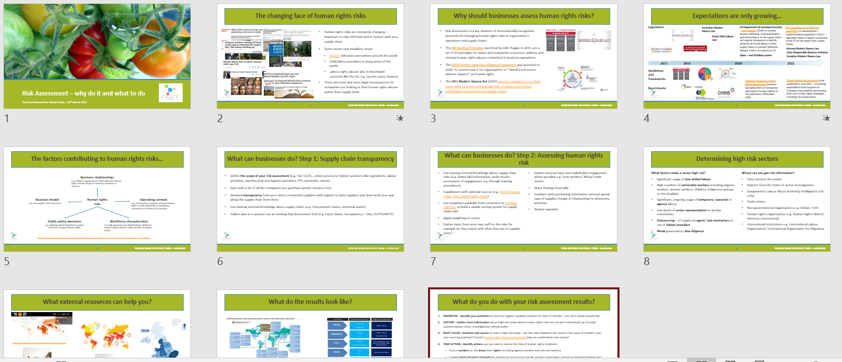
Risk Assessment presentation for suppliers – now available for members
https://foodnetworkforethicaltrade.com/mdocs-posts/fnet-supplier-ra-guide/
15

Slide 16
Next steps - Member comments
Actions:
Update existing FNET consultant/ contact list – Louise/ Leonie to follow up with members
Update existing FNET member expertise register to include case studies and on the ground work – Louise/ Leonie to follow up
NGO list of who is working where and how they work – Louise/ Leonie to follow up
Drawing learnings about collaborations from members – Louise/ Leonie to follow up with members
Would members be interested in, and willing to find, more in-depth research into high-risk countries by an external organisation e.g.
  China
  India
  Brazil
  Turkey
  Other?
To be looked at alongside updating the FNET Risk Assessment Tool
16

Slide 17


Wrap up, next meeting agenda & AOB
17

